Slide 1
The DDI Approach to Features:
Don’t Do It
25 years ago, the IBM Speech Group tossed a bomb shell
  There is no data like more data (Mercer, 1985)
  DDI: More data >> thinking (algorithms, features, etc.)
15 years ago, Web → More data (so no need to think)
  But although the Web is Large, it isn’t that large
  Solitaire → Multi-Player Game
    Authors, Users, Advertisers, Spammers
    Features about Readers >> Features about Writers (tf, IDF, Page Rank)
  Learning to Rank → Pro-features (Anti-DDI)
Recent return to DDI
  Zero Resources & Speech + Classification
  Standard Practice (e.g., Gale):
    Connect black boxes (speech, IR, NLP) in Series
    Multiply Errors
    NA for low resource languages (all but English, Chinese, Arabic)
  Proposed alternative: Apply Classification directly to speech
    Without taking a dependency on ASR (Speech Recognition)

Slide 2
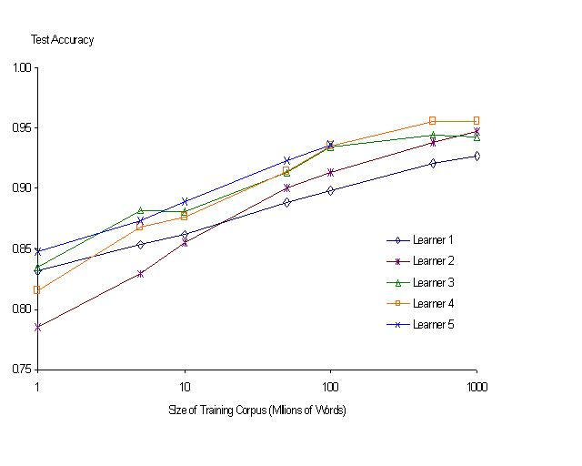
“It never pays to think until you’ve run out of data” – Eric Brill
Moore’s Law Constant:
Data Collection Rates → Improvement Rates
Banko & Brill: Mitigating the Paucity-of-Data Problem (HLT 2001)
No consistently
best learner
1000x per decade
There is no data like more data
Quoted out of context
Fire everybody and
spend the money on data

Slide 3
Motivation for Information Retrieval
(circa 1990, about 5 years before web)
Text is available like never before
Currently, N≈100 million words
  and projections run as high as 10¹⁵ bytes by 2000!
What can we do with it all?
  It is better to do something simple,
  than nothing at all.
IR vs. Natural Language Understanding
  Revival of 1950-style empiricism

Slide 4
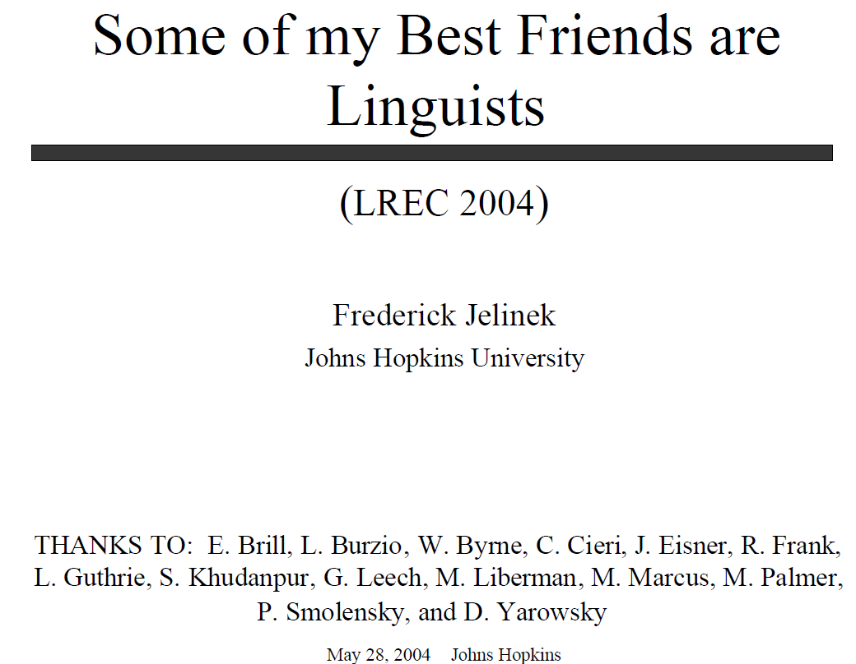

Slide 5
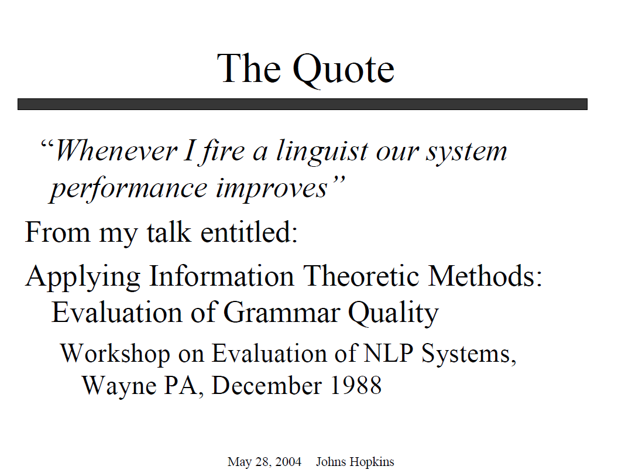

Slide 6
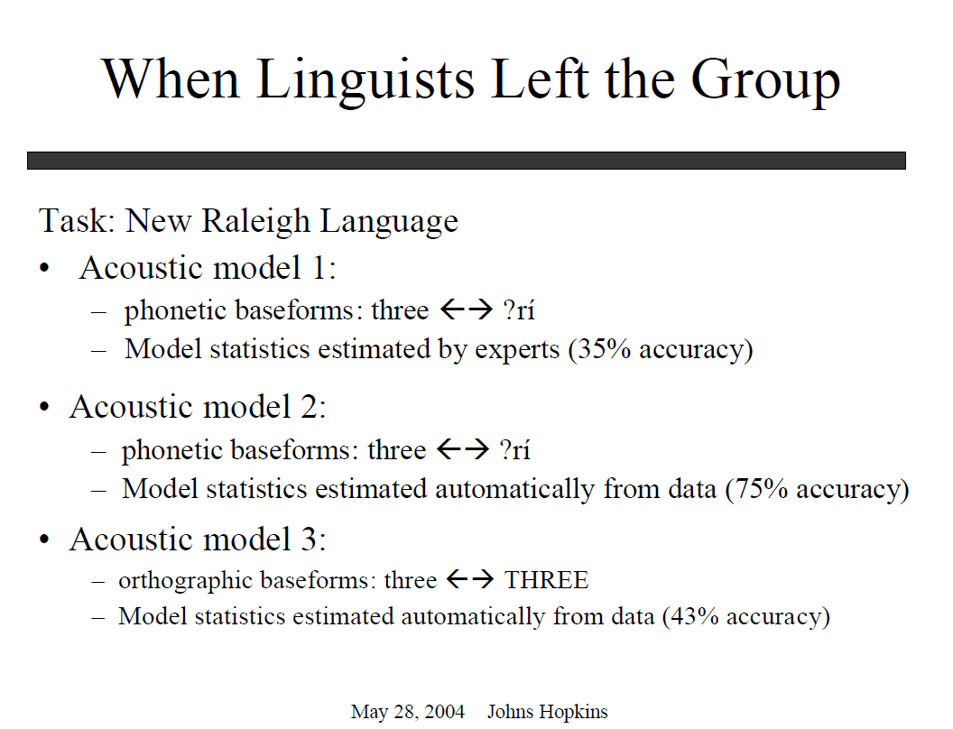

Slide 7
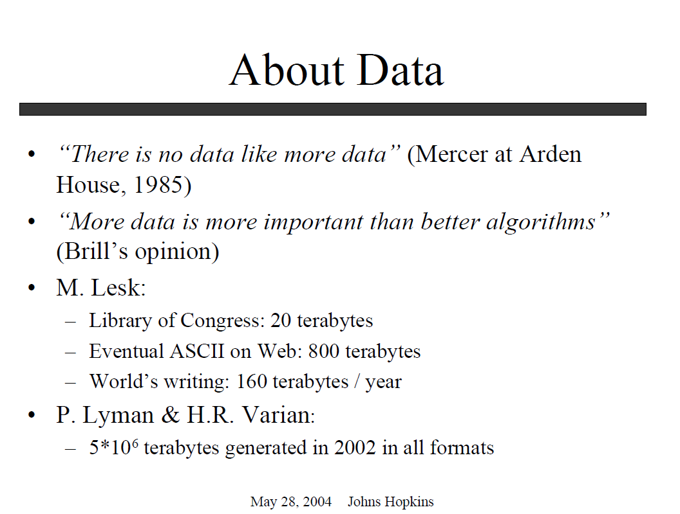

Slide 8
How Large is Very Large?
From a Keynote to EMNLP Conference, formally Workshop on Very Large Corpora

Slide 9
The DDI Approach to Features:
Don’t Do It
25 years ago, the IBM Speech Group tossed a bomb shell
  There is no data like more data (Mercer, 1985)
  DDI: More data >> thinking (algorithms, features, etc.)
15 years ago, Web → More data (so no need to think)
  But although the Web is Large, it isn’t that large
  Solitaire → Multi-Player Game
    Authors, Users, Advertisers, Spammers
    Features about Readers >> Features about Writers (tf, IDF, Page Rank)
  Learning to Rank → Pro-features (Anti-DDI)
Recent return to DDI
  Zero Resources & Speech + Classification
  Standard Practice (e.g., Gale):
    Connect black boxes (speech, IR, NLP) in Series
    Multiply Errors
    NA for low resource languages (all but English, Chinese, Arabic)
  Proposed alternative: Apply Classification directly to speech
    Without taking a dependency on ASR (Speech Recognition)

Slide 10
Entropy of Search Logs
- How Big is the Web?
- How Hard is Search?
- With Personalization? With Backoff?
WSDM-2008
Qiaozhu Mei†, Kenneth Church‡
† University of Illinois at Urbana-Champaign
‡ Microsoft Research

Slide 11
How Big is the Web?
5B? 20B? More? Less?
Small
What if a small cache of millions of pages
  Could capture much of the value of billions?
Could a Big bet on a cluster in the clouds
  Turn into a big liability?
Examples of Big Bets
  Computer Centers & Clusters
    Capital (Hardware)
    Expense (Power)
    Dev (Mapreduce, GFS, Big Table, etc.)
  Sales & Marketing >> Production & Distribution

Slide 12
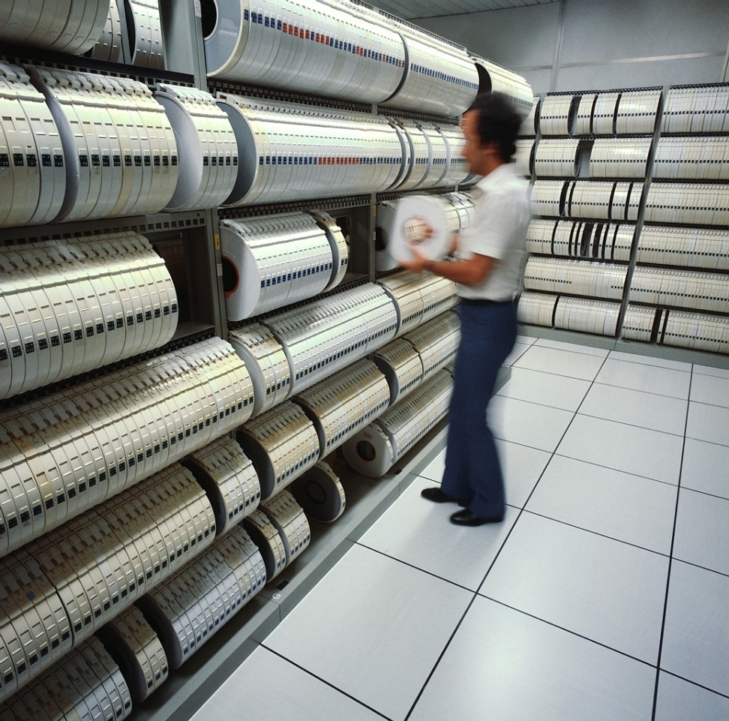
Millions (Not Billions)

Slide 13
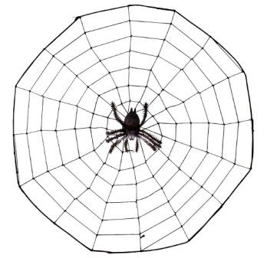
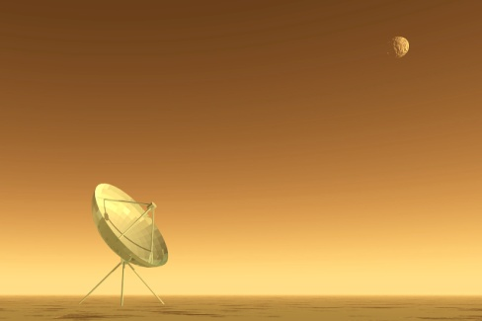

Population Bound
With all the talk about the Long Tail
  You’d think that the Web was astronomical
  Carl Sagan: Billions and Billions…
Lower Distribution $$ → Sell Less of More
But there are limits to this process
  NetFlix: 55k movies (not even millions)
  Amazon: 8M products
  Vanity Searches: Infinite???
    Personal Home Pages << Phone Book < Population
    Business Home Pages << Yellow Pages < Population
Millions, not Billions (until market saturates)

Slide 14
It Will Take Decades to Reach Population Bound
Most people (and products)
  don’t have a web page (yet)
Currently, I can find famous people
    (and academics)
    but not my neighbors
  There aren’t that many famous people
    (and academics)…
  Millions, not billions
    (for the foreseeable future)

Slide 15
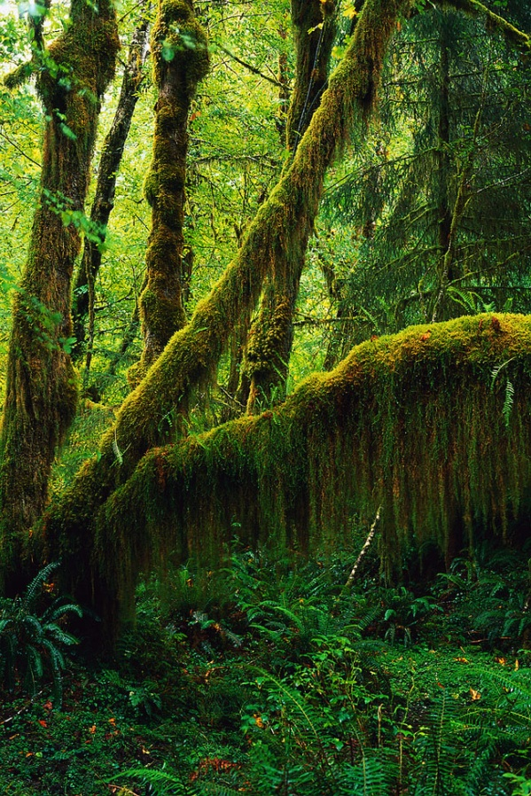
Equilibrium: Supply = Demand
If there is a page on the web,
  And no one sees it,
  Did it make a sound?
How big is the web?
  Should we count “silent” pages
  That don’t make a sound?
How many products are there?
  Do we count “silent” flops
  That no one buys?

Slide 16
Demand Side Accounting
Consumers have limited time
  Telephone Usage: 1 hour per line per day
  TV: 4 hours per day
  Web: ??? hours per day
Suppliers will post as many pages as consumers can consume (and no more)
Size of Web: O(Consumers)

Slide 17
How Big is the Web?
Related questions come up in language
How big is English?
  Dictionary Marketing
  Education (Testing of Vocabulary Size)
  Psychology
  Statistics
  Linguistics
Two Very Different Answers
  Chomsky: language is infinite
  Shannon: 1.25 bits per character
How many words do people know?
What is a word? Person? Know?
Notes:
There are two very different answers from the computational perspective:

Slide 18
Chomskian Argument:
Web is Infinite
One could write a malicious spider trap
  http://successor.aspx?x=0 → http://successor.aspx?x=1 → http://successor.aspx?x=2
Not just academic exercise
Web is full of benign examples like
  http://calendar.duke.edu/
  Infinitely many months
  Each month has a link to the next

Slide 19
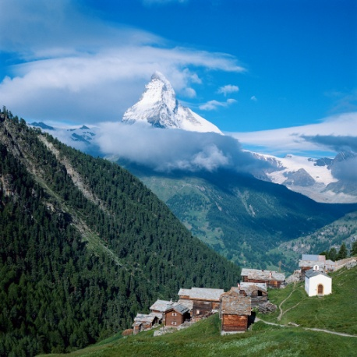
How Big is the Web?
5B? 20B? More? Less?
 | Entropy (H)
Query | 21.1 → 22.9
URL | 22.1 → 22.4
IP | 22.1 → 22.6
All But IP | 23.9
All But URL | 26.0
All But Query | 27.1
All Three | 27.2
MSN Search Log
1 month → x18
More (Chomsky)
  http://successor?x=0
Less (Shannon)
More Practical Answer
Comp Ctr ($$$$) → Walk in the Park ($)
Millions
(not Billions)
Cluster in Cloud → Desktop → Flash

Slide 20
Entropy (H)
  Size of search space; difficulty of a task
H = 20 → 1 million items distributed uniformly
Powerful tool for sizing challenges and opportunities
  How hard is search?
  How much does personalization help?

Slide 21
How Hard Is Search?
Millions, not Billions
Traditional Search
  H(URL | Query)
  2.8 (= 23.9 – 21.1)
Personalized Search
  H(URL | Query, IP)
  1.2 (= 27.2 – 26.0)
 | Entropy (H)
Query | 21.1
URL | 22.1
IP | 22.1
All But IP | 23.9
All But URL | 26.0
All But Query | 27.1
All Three | 27.2
Personalization cuts H in Half!

Slide 22
How Hard are Query Suggestions?
The Wild Thing? C* Rice → Condoleezza Rice
Traditional Suggestions
  H(Query)
  21 bits
Personalized
  H(Query | IP)
  5 bits (= 26 – 21)
 | Entropy (H)
Query | 21.1
URL | 22.1
IP | 22.1
All But IP | 23.9
All But URL | 26.0
All But Query | 27.1
All Three | 27.2
Personalization cuts H in Half!
Twice

Slide 23
Personalization with Backoff
Ambiguous query: MSG
  Madison Square Garden
  Monosodium Glutamate
Disambiguate based on user’s prior clicks
When we don’t have data
  Backoff to classes of users
Proof of Concept:
  Classes defined by IP addresses
Better:
  Market Segmentation (Demographics)
  Collaborative Filtering (Other users who click like me)

Slide 24
Conclusions: Millions (not Billions)
How Big is the Web?
  Upper bound: O(Population)
    Not Billions
    Not Infinite
Shannon >> Chomsky
  How hard is search?
  Query Suggestions?
  Personalization?
Cluster in Cloud ($$$$) → Walk-in-the-Park ($)
Entropy is a great hammer

Slide 25
The DDI Approach to Features:
Don’t Do It
25 years ago, the IBM Speech Group tossed a bomb shell
  There is no data like more data (Mercer, 1985)
  DDI: More data >> thinking (algorithms, features, etc.)
15 years ago, Web → More data (so no need to think)
  But although the Web is Large, it isn’t that large
  Solitaire → Multi-Player Game
    Authors, Users, Advertisers, Spammers
    Features about Readers >> Features about Writers (tf, IDF, Page Rank)
  Learning to Rank → Pro-features (Anti-DDI)
Recent return to DDI
  Zero Resources & Speech + Classification
  Standard Practice (e.g., Gale):
    Connect black boxes (speech, IR, NLP) in Series
    Multiply Errors
    NA for low resource languages (all but English, Chinese, Arabic)
  Proposed alternative: Apply Classification directly to speech
    Without taking a dependency on ASR (Speech Recognition)

Slide 26
Solitaire → Multi-Player Game
Solitaire:
  The User v. The House (Library)
Multi-Player Game:
  Authors
  Users
  Advertisers
  Spammers
  SEOs (Search Engine Optimizers)

Slide 27
Big City
Good Guys & Bad Guys working cross purposes
  Authors, Users, Advertisers, Spammers
  We’re not in Kansas any more
Traditional features (tf, IDF, Page Rank)
  Shed light on authors
But readers want readers’ perspective (clicks)
  Readers’ perspective >> Writers’ perspective
    Since there are more readers than writers
    Logs of user behavior (readers) >> Web pages (writers)

Slide 28
Noisy Channel Model for Web Search
Michael Bendersky
Input → Noisy Channel → Output
  Input’ ≈ ARGMAX_{Input} Pr( Input ) * Pr( Output | Input )
Speech
  Words → Acoustics
  Pr( Words ) * Pr( Acoustics | Words )
Machine Translation
  English → French
  Pr( English ) * Pr ( French | English )
Web Search
  Web Pages → Queries
  Pr( Web Page ) * Pr ( Query | Web Page )
Prior
Channel Model
Prior
Channel Model

Slide 29
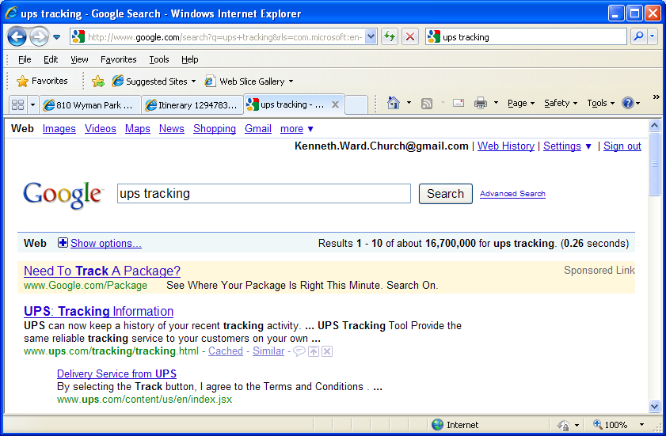
Prior Work on Document Priors
Page Rank (Brin & Page, 1998)
  Incoming link votes
Browse Rank (Liu et al., 2008)
  Clicks, toolbar hits
Textual Features (Kraaij et al., 2002)
  Document length, URL length, anchor text
  <a href="http://en.wikipedia.org/wiki/Main_Page">Wikipedia</a>

Slide 30
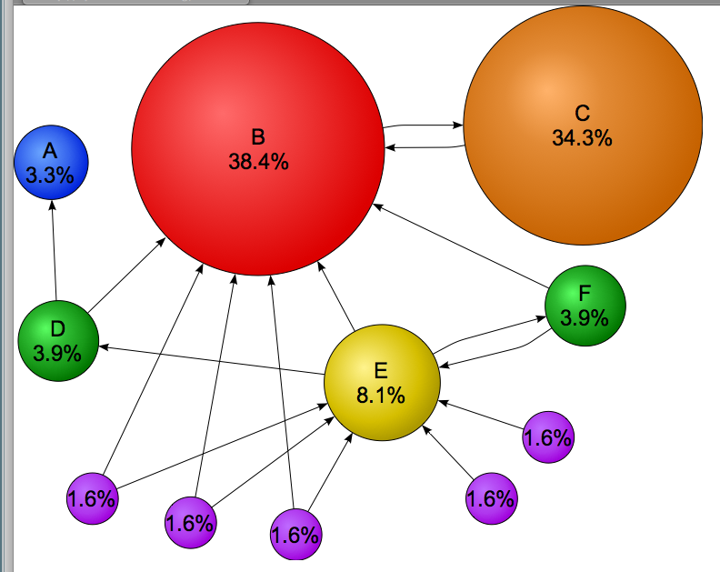
Page Rank (named after Larry Page) aka Static Rank & Random Surfer Model

Slide 31
Document Priors
Random Walks on Query-URL Graphs
  Guilt by association
  URLs near likely queries (and queries near likely URLs) → more likely
Human Ratings (HRS): Perfect judgments → more likely
Static Rank (Page Rank): higher → more likely
Textual Overlap: match → more likely
  “cnn” → www.cnn.com (match)
Popular:
  lots of clicks → more likely (toolbar, slogs, glogs)
Diversity/Entropy:
  fewer plausible queries → more likely
Broder’s Taxonomy
  “cnn” → www.cnn.com (navigational)

Slide 32
Learning to Rank: Task Definition
What will determine future clicks on the URL?
  Past Clicks ?
  High Static Rank ?
  High Toolbar visitation counts ?
  Precise Textual Match ?
  All of the Above ?
~3k queries from the extracts
  350k URL’s
  Past Clicks: February – May, 2008
  Future Clicks: June, 2008

Slide 33
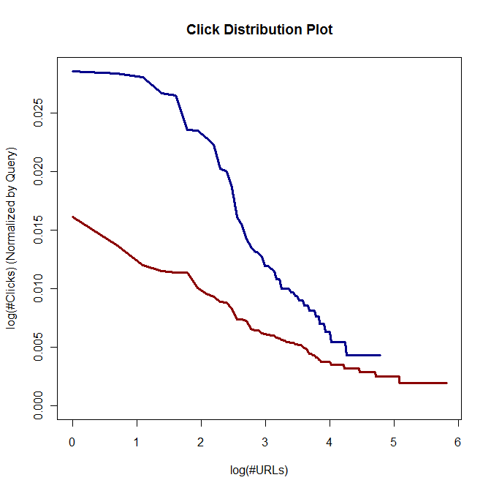
Informational vs. Navigational Queries
  Fewer plausible URL’s → easier query
  Click Entropy
    Less is easier
  Broder’s Taxonomy:
    Navigational / Informational
    Navigational is easier:
      “BBC News” (navigational) easier than “news”
  Less opportunity for personalization
    (Teevan et al., 2008)
“bbc news”
“news”
Navigational queries have smaller entropy

Slide 34
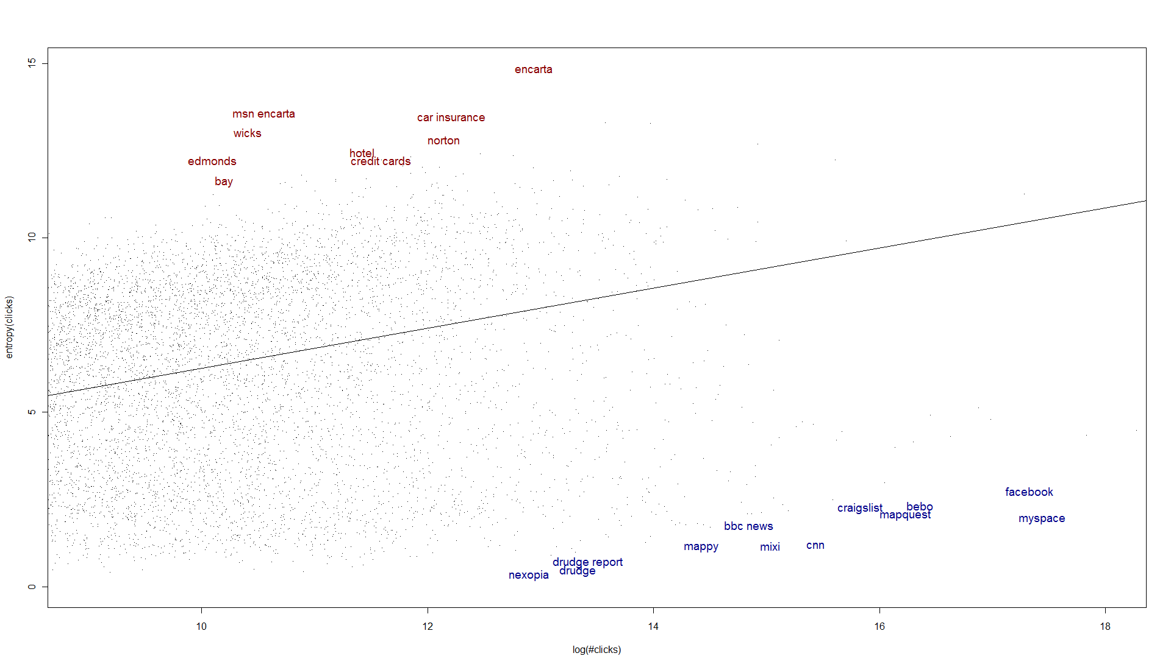
Informational/Navigational by Residuals
Informational
Navigational
ClickEntropy ~ Log(#Clicks)

Slide 35
Alternative Taxonomy: Click Types
Classify queries by type
  Problem: query logs have no “informational/navigational” labels
Instead, we can use logs to categorize queries
  Commercial Intent → more ad clicks
  Malleability → more query suggestion clicks
  Popularity → more future clicks (anywhere)
    Predict future clicks ( anywhere )
      Past Clicks: February – May, 2008
      Future Clicks: June, 2008
App: Allocation of Space on Page across Org

Slide 36
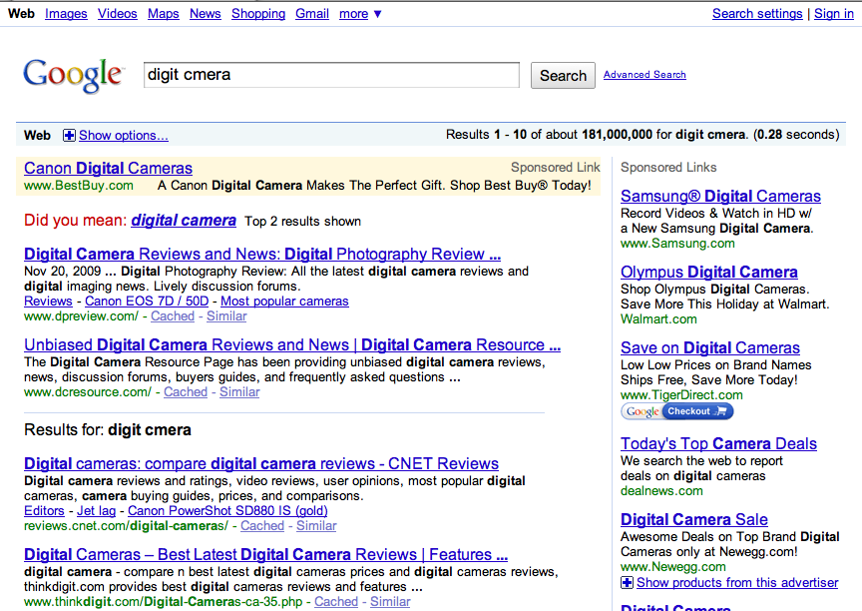
Left Rail
Query
Right Rail
Mainline Ad
Spelling Suggestions
Snippet

Slide 37
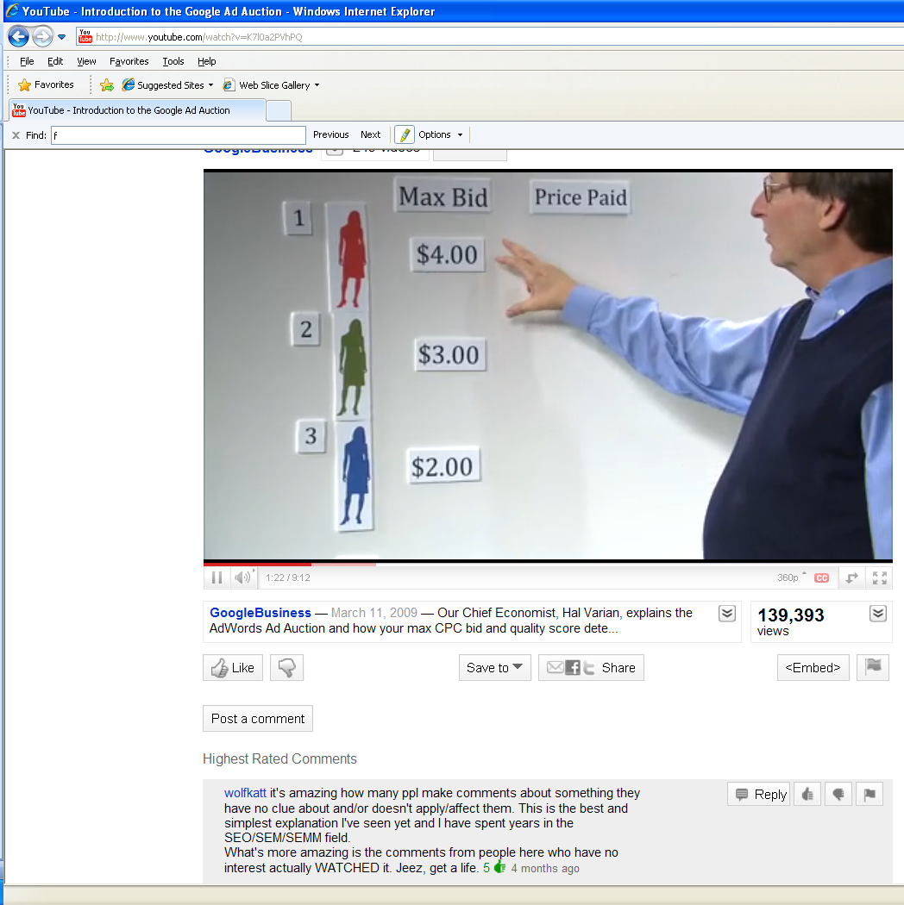
Paid Search http://www.youtube.com/watch?v=K7l0a2PVhPQ

Slide 38
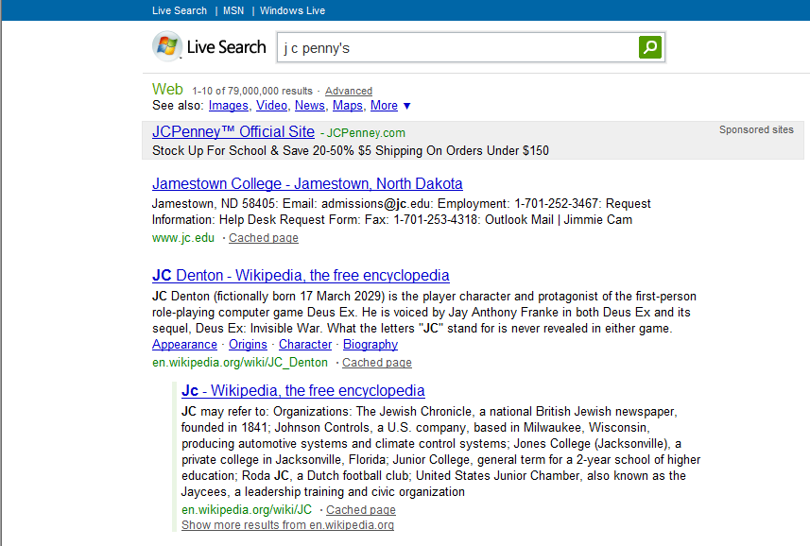
Emily Pitler’s DSAT (Dissatisfaction) Heuristic:
DSAT → Opportunity for Ads
Coordination Across Orgs → Auction
89.2% ad clicks

Slide 39
Spelling Suggestions: More than a suggestion
Entropy(Spelling Click | Query) | .01
Entropy(Spelling Click) | .11
Entropy(Spelling Click | User) | .08
google.co9m 97.1%
tmz.om 96.3%
raiglist 95.7%
City TV Toronto 0.0%
sink holes 0.0%
mens style 0.0%
Queries with clicks, June 1-7, 2008, en-us market, bot filtered

Slide 40
Different Types of User Intent
Spelling Suggestion www.lastmintue.com.au | Ads ebay official
Query Suggestion princess game disney | Algo. Results craigslist, denver, co

Slide 41
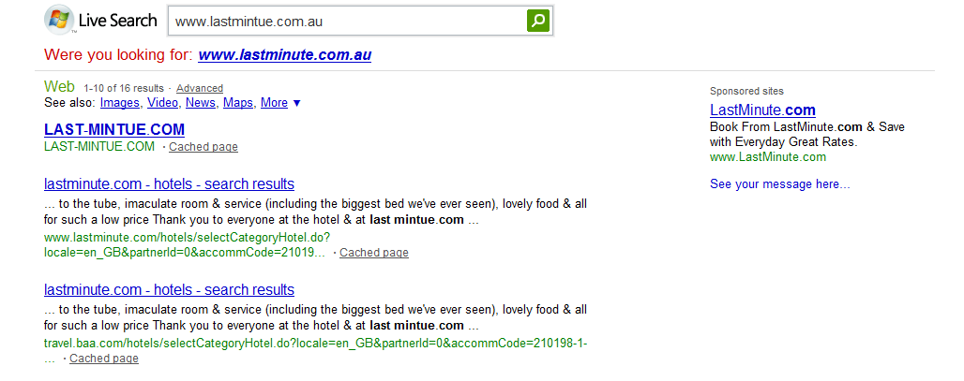
www.lastmintue.com.au
100% Spelling Suggestion Clicks

Slide 42
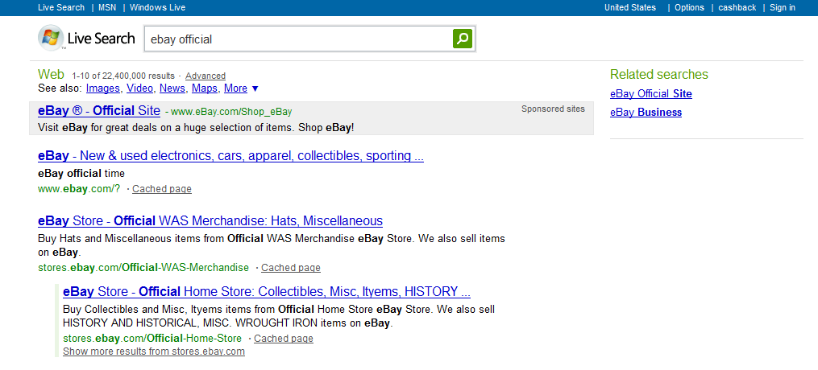
ebay official
98% Ad Clicks

Slide 43
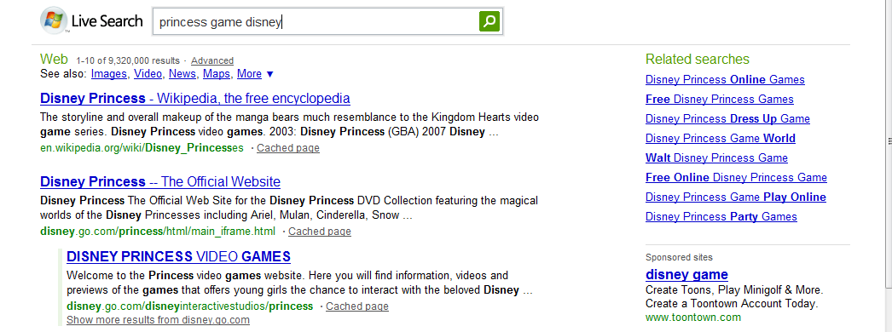
princess game disney
96% Query Suggestion Clicks

Slide 44
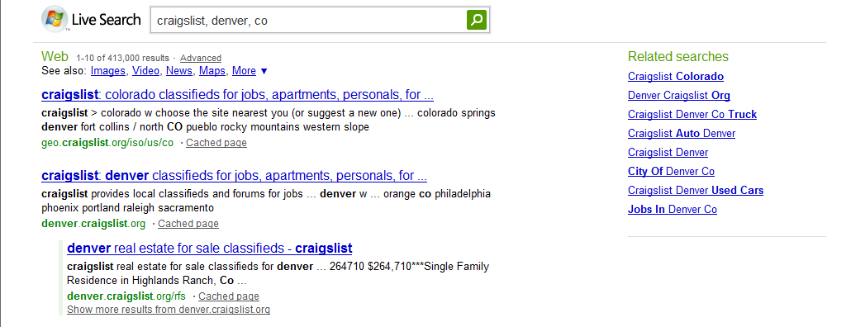
craigslist, denver, co
100% Algo Clicks

Slide 45
Random Walks → User Intent:
Guilt by Association
ebay official
ebay.com
ebay
upenn bookstore
upenn.bncollege.com
upenn
upenn.edu

Slide 46
URLs → User Intents
Spelling Suggestion www.youtube.com www.cartoonnetwork.com www.wikipedia.org | Ads www.cheapflights.com www.bluemountain.com www.expedia.com
Query Suggestion games.yahoo.com music.aol.com www.kbb.com | Algo Results www.fcc.gov babelfish.altavista.com www.mapquest.com

Slide 47
The DDI Approach to Features:
Don’t Do It
25 years ago, the IBM Speech Group tossed a bomb shell
  There is no data like more data (Mercer, 1985)
  DDI: More data >> thinking (algorithms, features, etc.)
15 years ago, Web → More data (so no need to think)
  But although the Web is Large, it isn’t that large
  Solitaire → Multi-Player Game
    Authors, Users, Advertisers, Spammers
    Features about Readers >> Features about Writers (tf, IDF, Page Rank)
  Learning to Rank → Pro-features (Anti-DDI)
Recent return to DDI
  Zero Resources & Speech + Classification
  Standard Practice (e.g., Gale):
    Connect black boxes (speech, IR, NLP) in Series
    Multiply Errors
    NA for low resource languages (all but English, Chinese, Arabic)
  Proposed alternative: Apply Classification directly to speech
    Without taking a dependency on ASR (Speech Recognition)

Slide 48
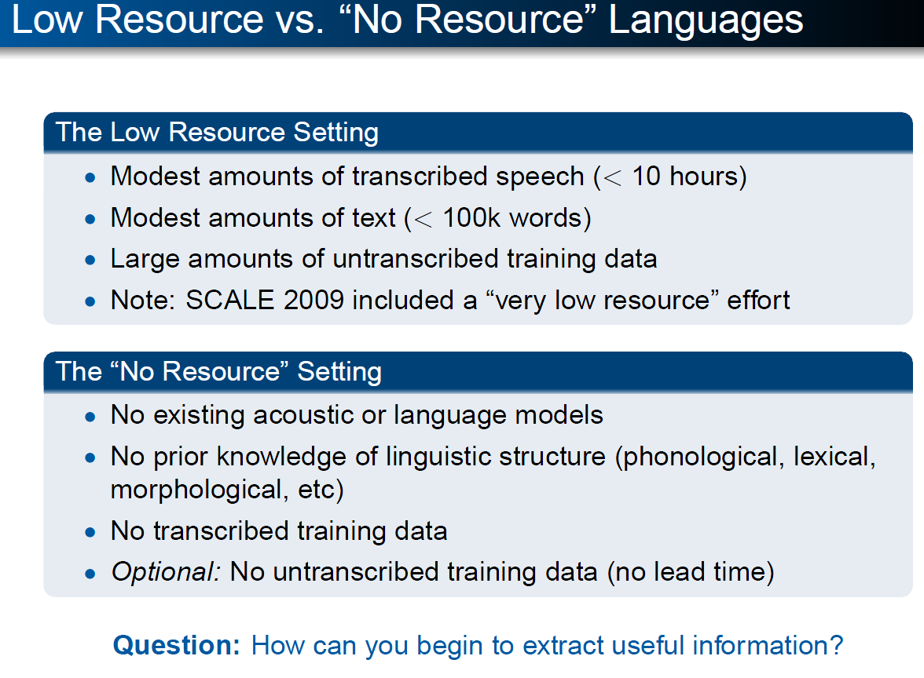

Slide 49
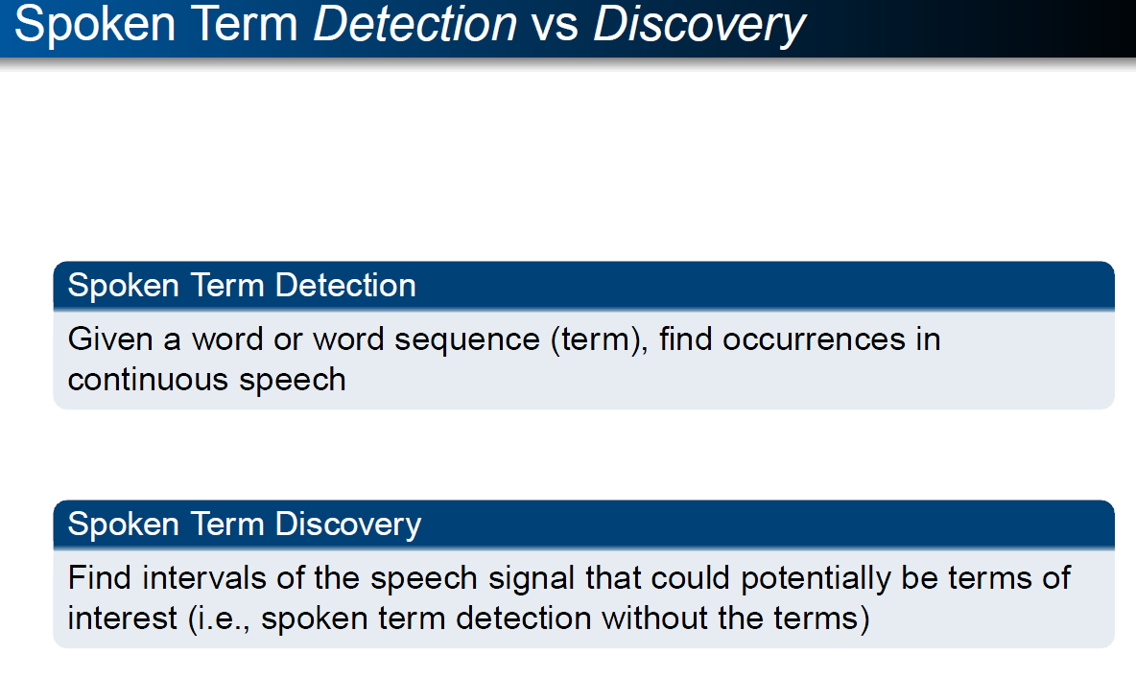

Slide 50
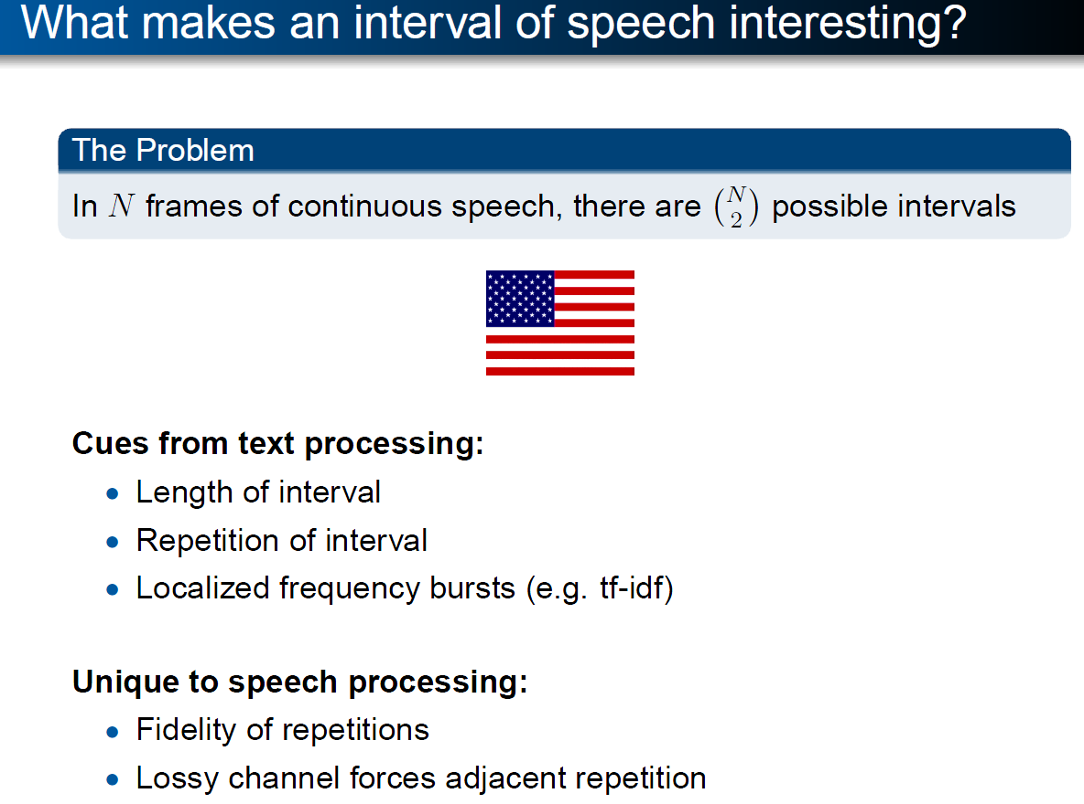


Slide 51
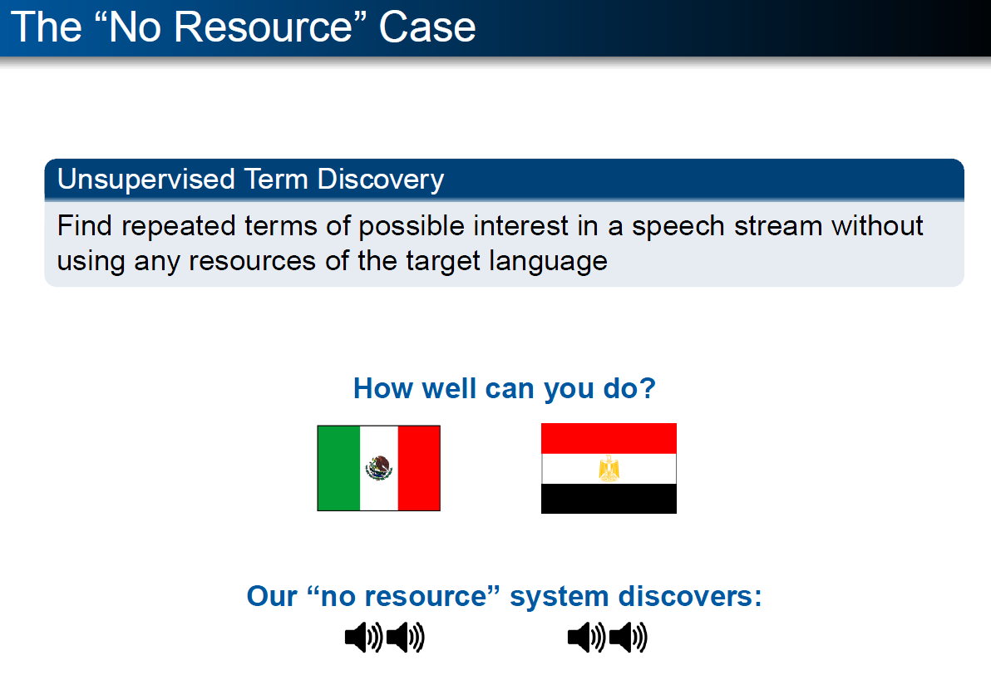

Slide 52
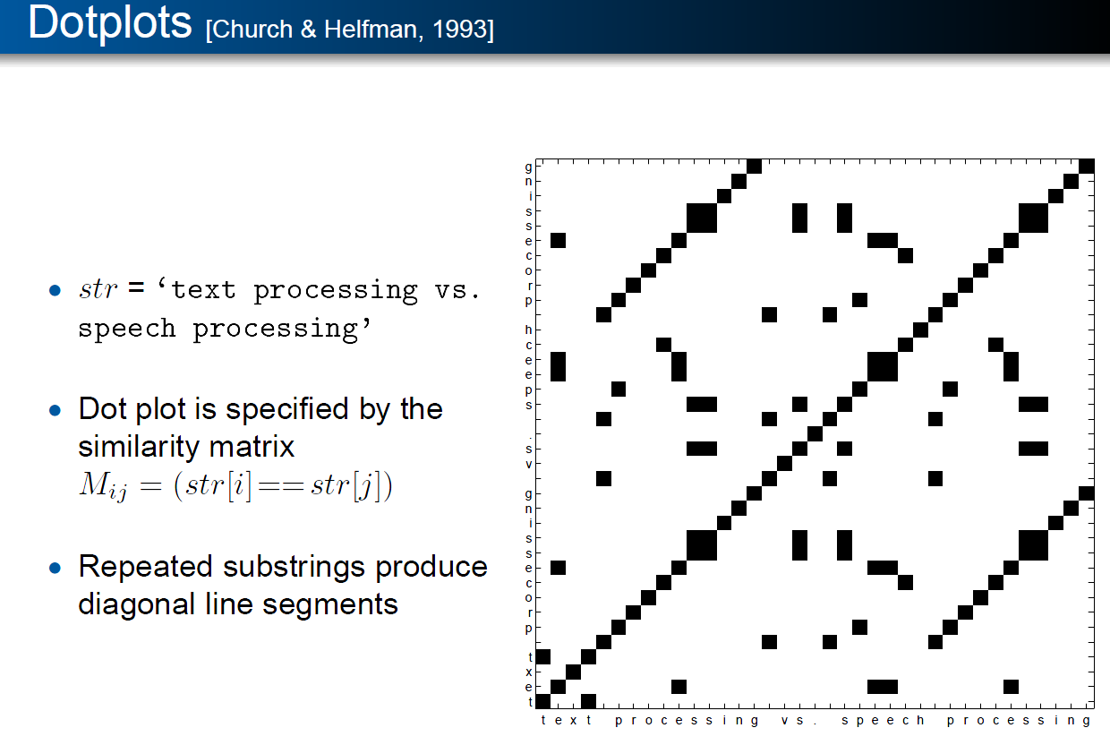

Slide 53
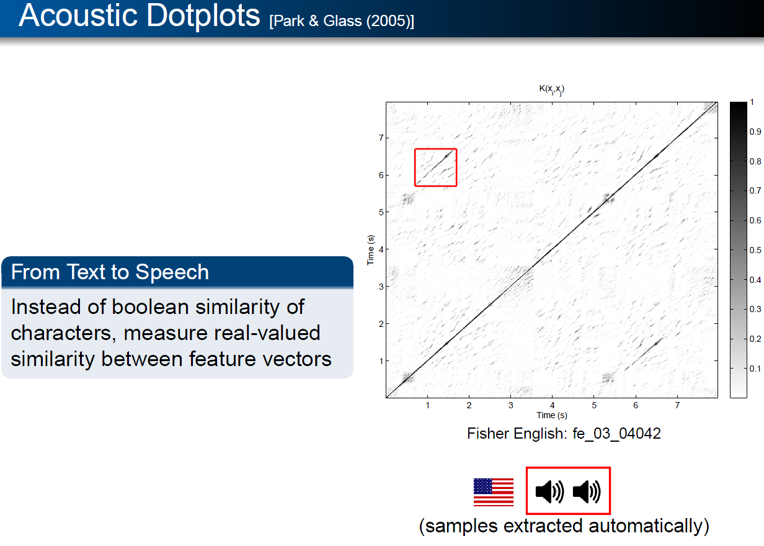

Slide 54
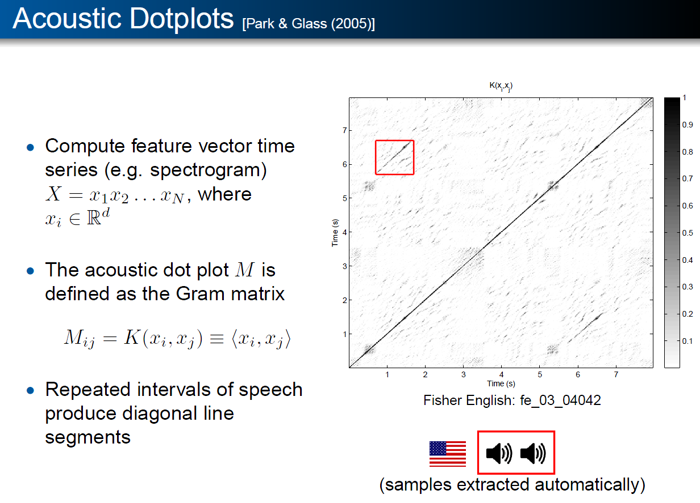

Slide 55
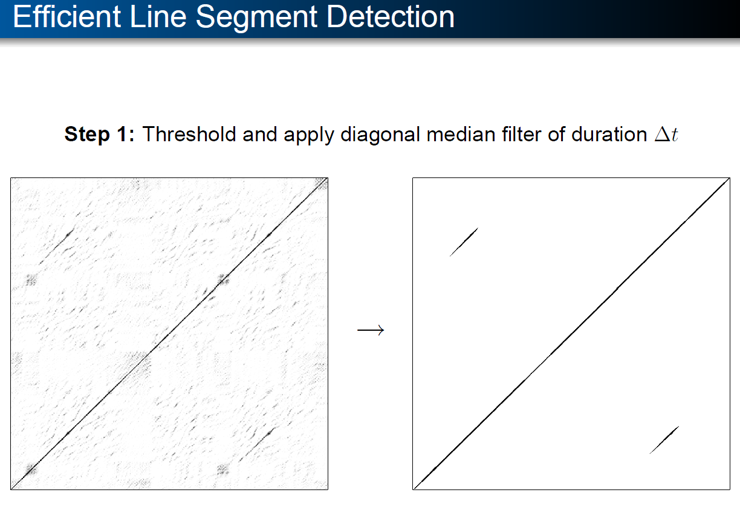

Slide 56
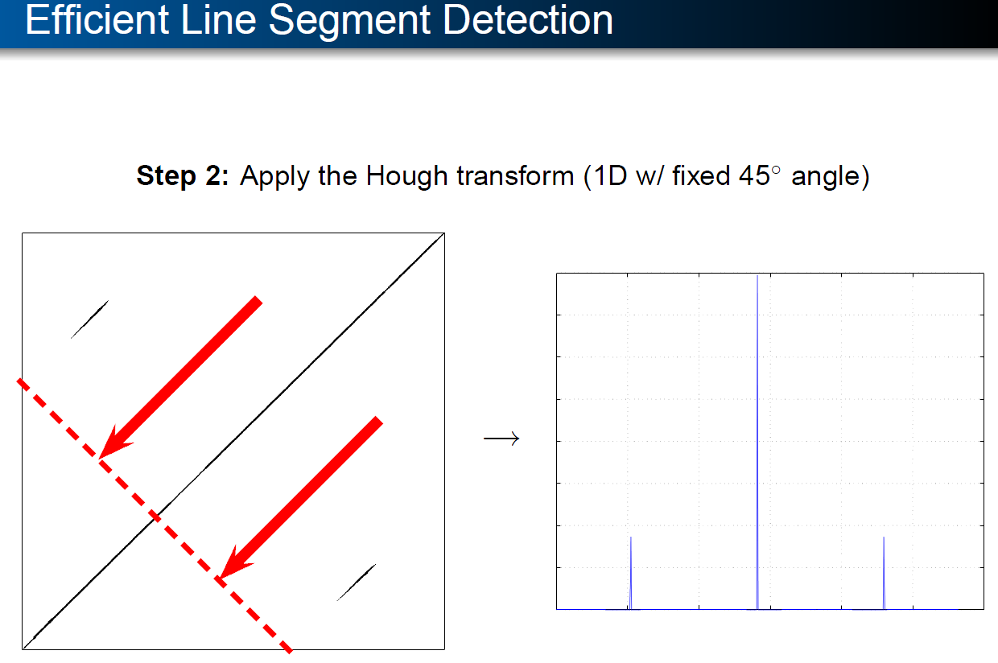

Slide 57
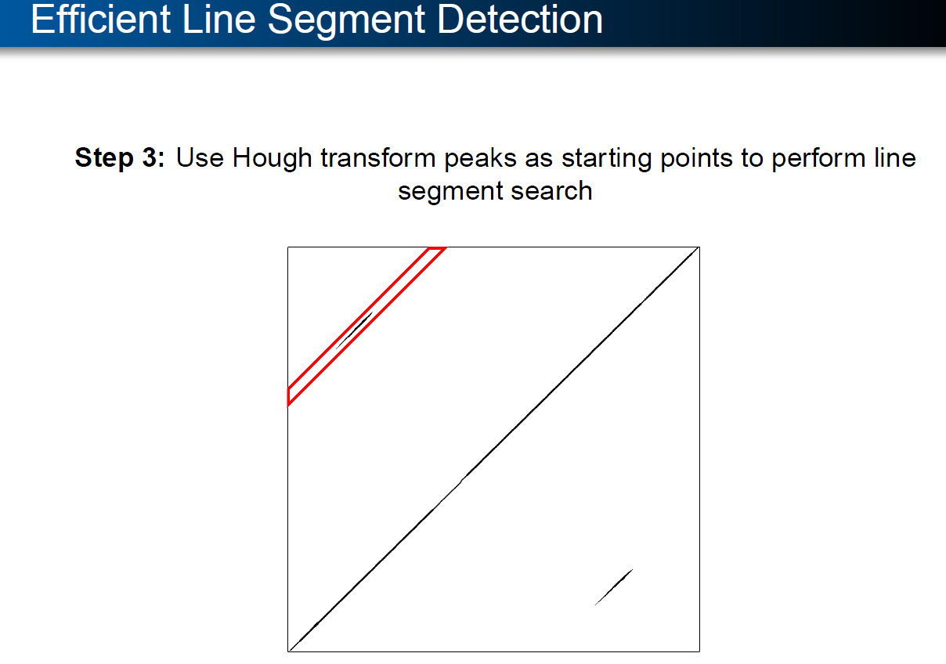

Slide 58
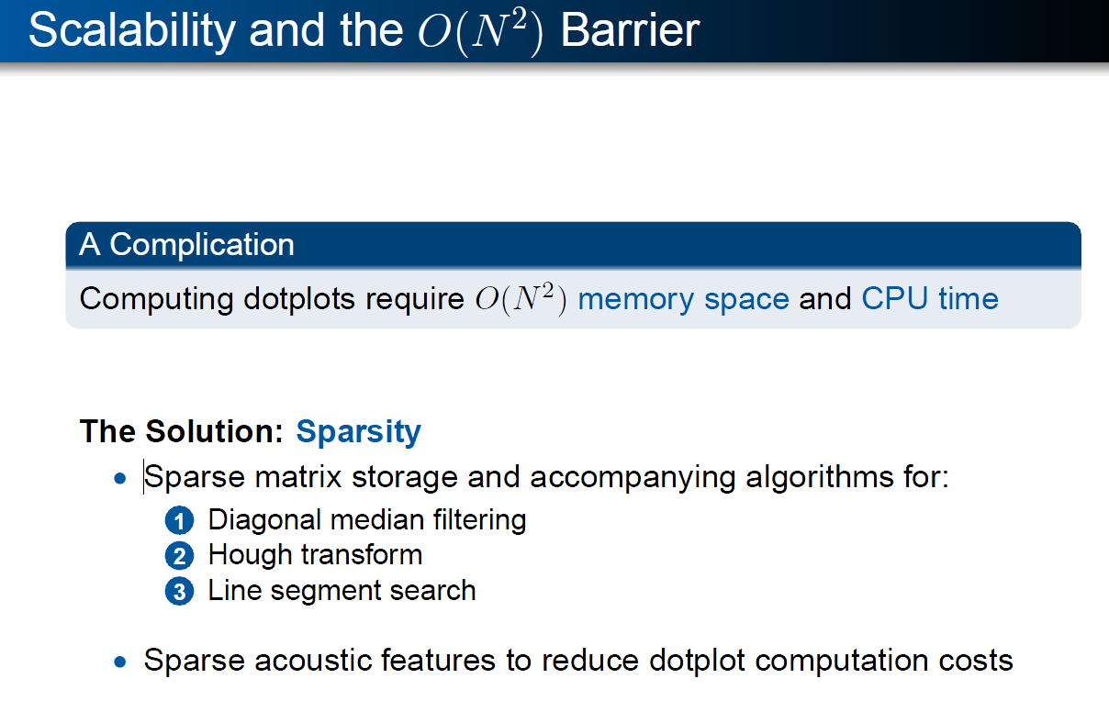

Slide 59
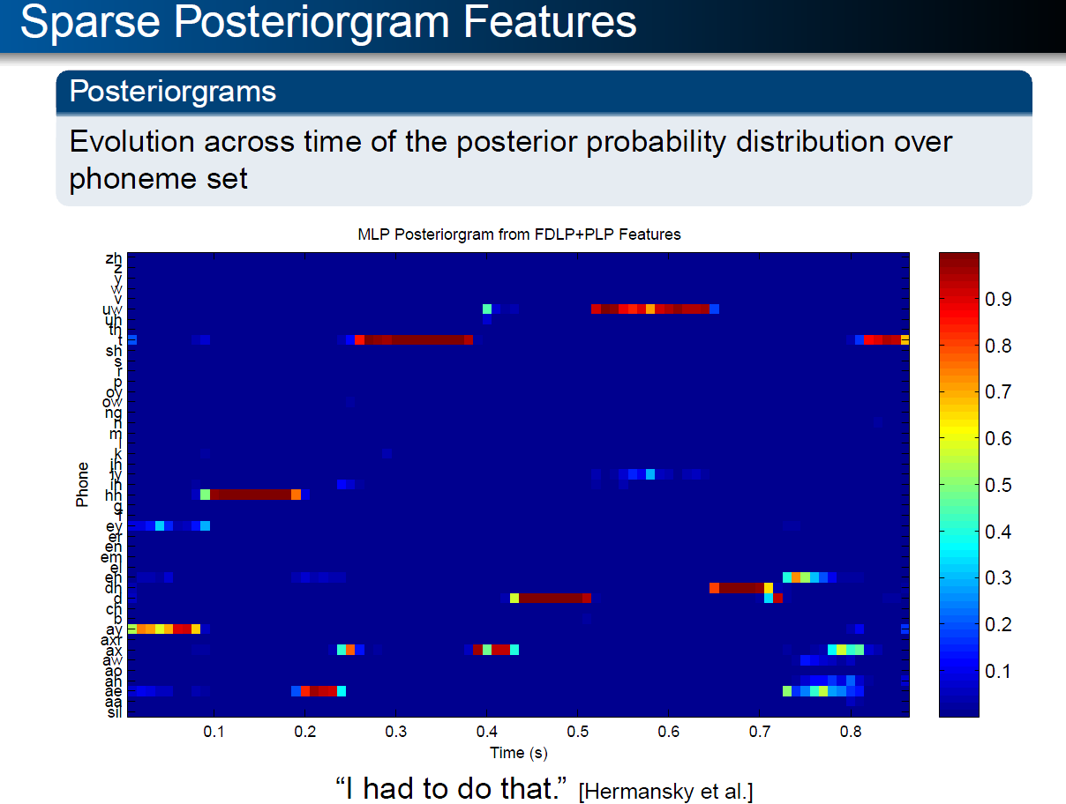

Slide 60
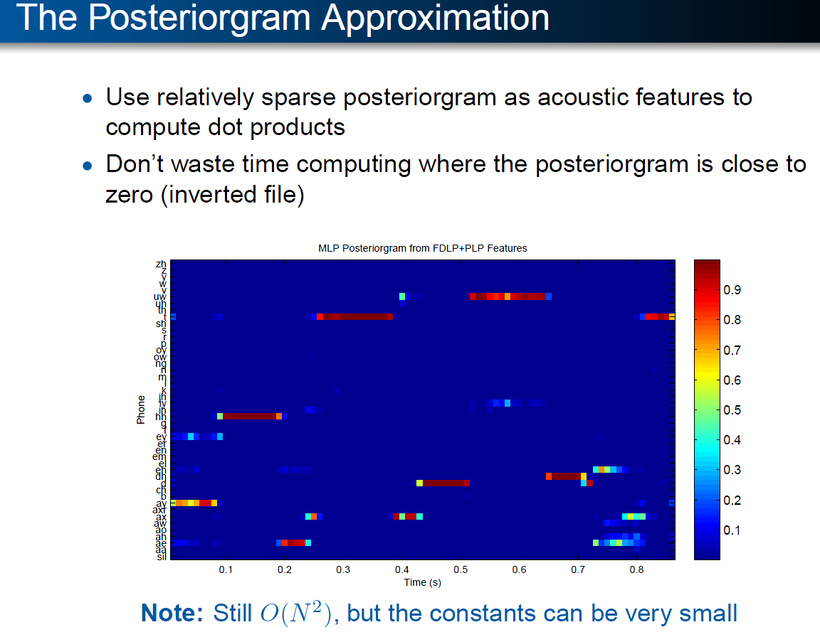

Slide 61
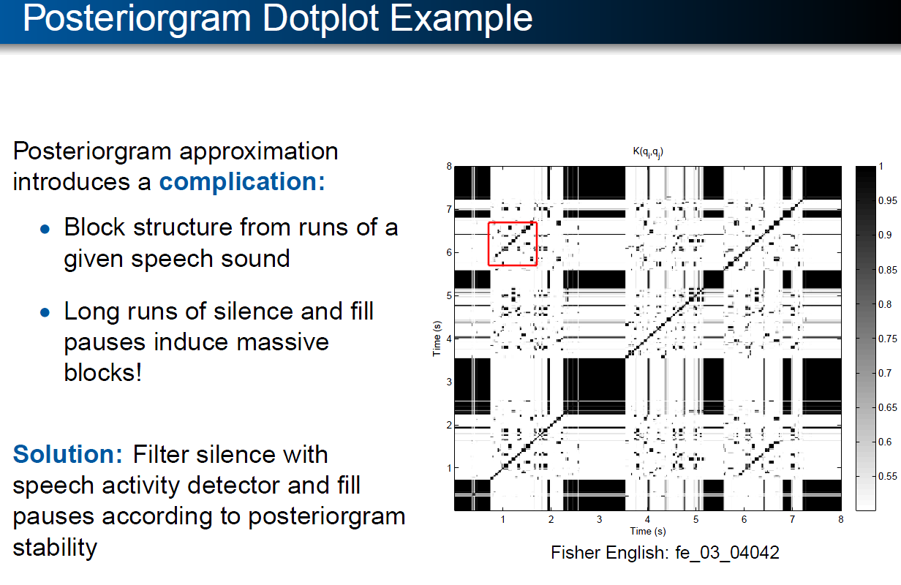

Slide 62
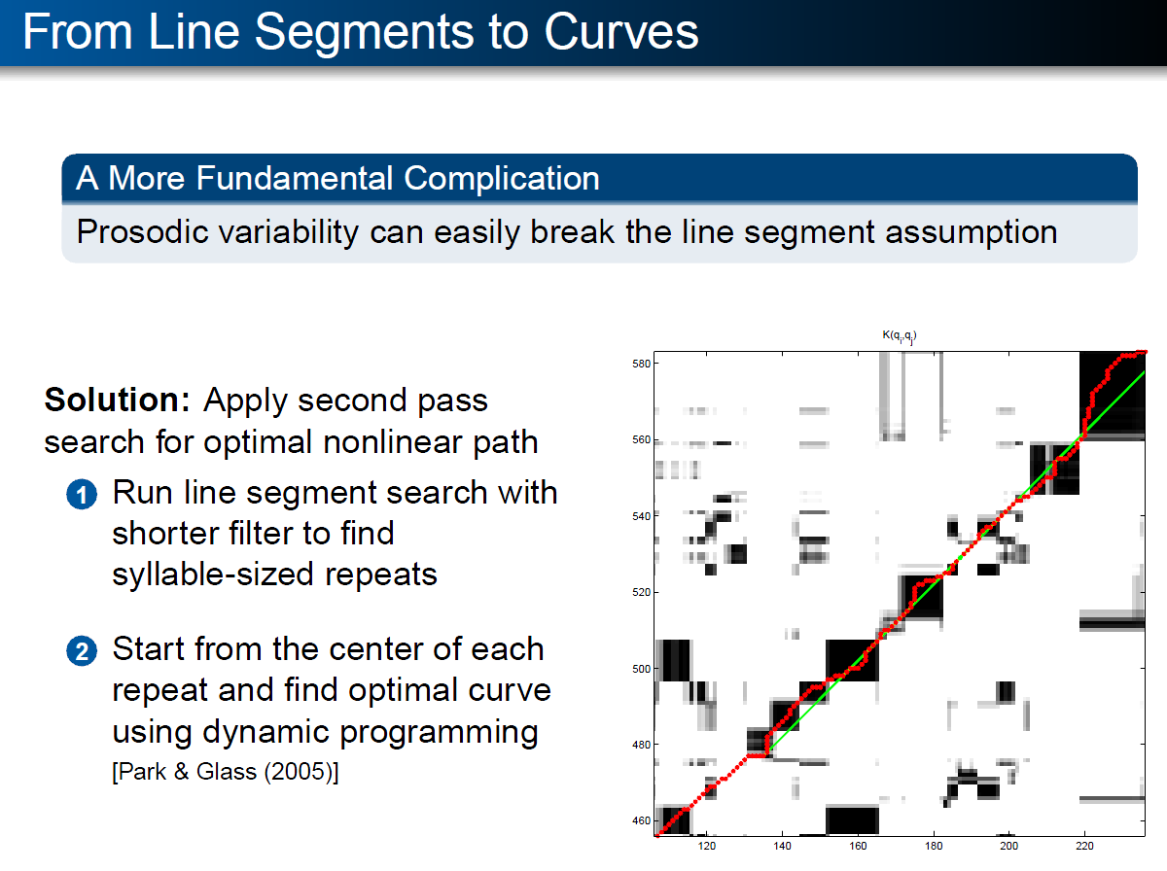

Slide 63
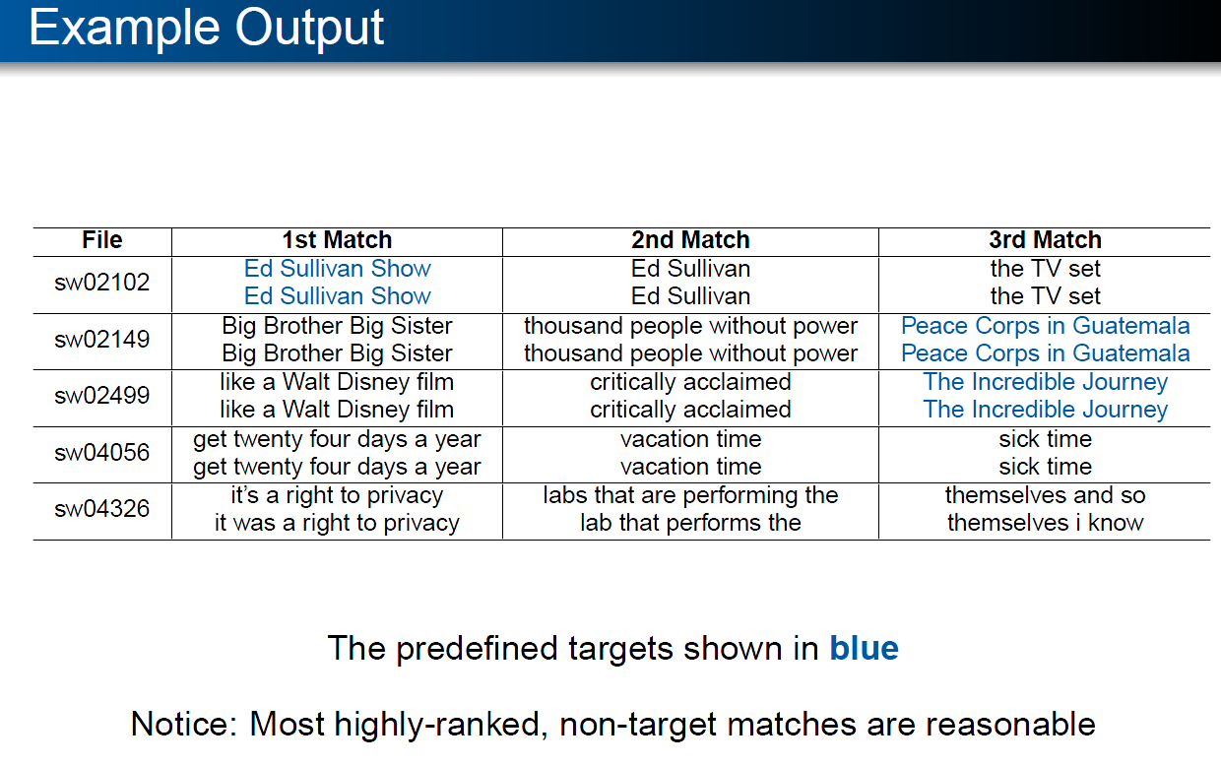

Slide 64
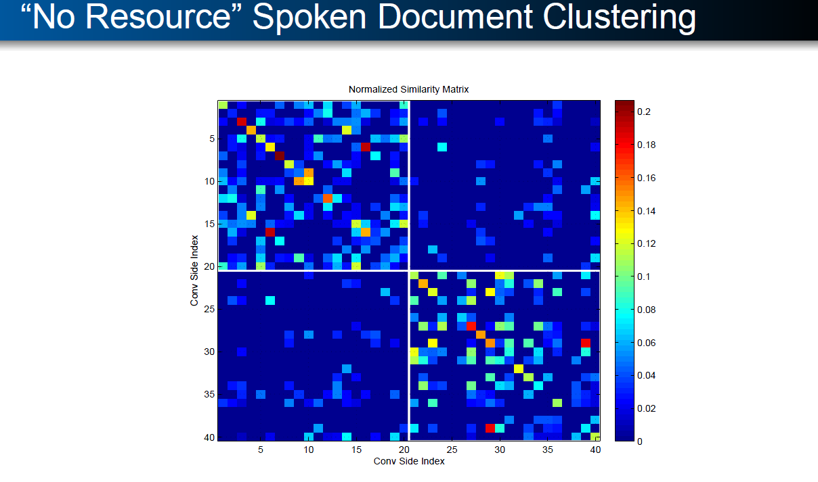
Spoken Term Discovery → Classification
(Without taking a dependency on ASR)

Slide 65
The DDI Approach to Features:
Don’t Do It
25 years ago, the IBM Speech Group tossed a bomb shell
  There is no data like more data (Mercer, 1985)
  DDI: More data >> thinking (algorithms, features, etc.)
15 years ago, Web → More data (so no need to think)
  But although the Web is Large, it isn’t that large
  Solitaire → Multi-Player Game
    Authors, Users, Advertisers, Spammers
    Features about Readers >> Features about Writers (tf, IDF, Page Rank)
  Learning to Rank → Pro-features (Anti-DDI)
Recent return to DDI
  Zero Resources & Speech + Classification
  Standard Practice (e.g., Gale):
    Connect black boxes (speech, IR, NLP) in Series
    Multiply Errors
    NA for low resource languages (all but English, Chinese, Arabic)
  Proposed alternative: Apply Classification directly to speech
    Without taking a dependency on ASR (Speech Recognition)

Slide 66
Backup

Slide 67
Summary: Information Retrieval (IR)
Boolean Combinations of Keywords
  Popular with Intermediaries (Librarians)
Rank Retrieval
  Sort a collection of documents
    (e.g., scientific papers, abstracts, paragraphs)
    by how much they ‘‘match’’ a query
  The query can be a (short) sequence of keywords
    or arbitrary text (e.g., one of the documents)
Logs of User Behavior (Clicks, Toolbar)
  Solitaire → Multi-Player Game:
    Authors, Users, Advertisers, Spammers
  More Users than Authors → More Information in Logs than Docs
  Learning to Rank:
    Use Machine Learning to combine doc features & log features

Slide 68
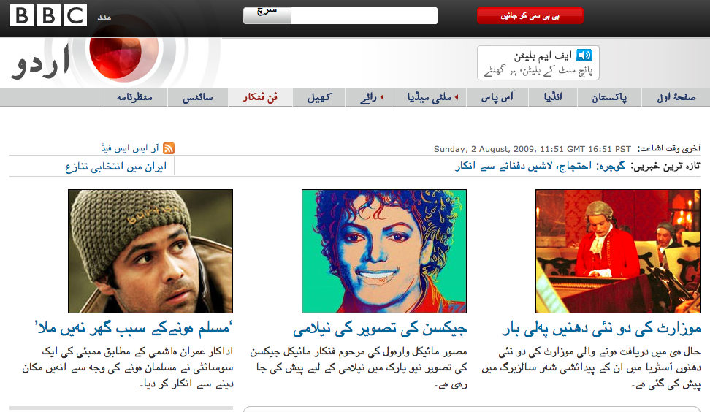
Matching on Non-Text
Features: Images, Markup, Publisher, Date

Slide 69
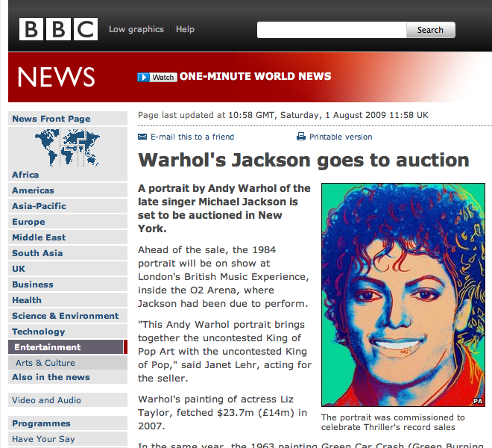

Slide 70
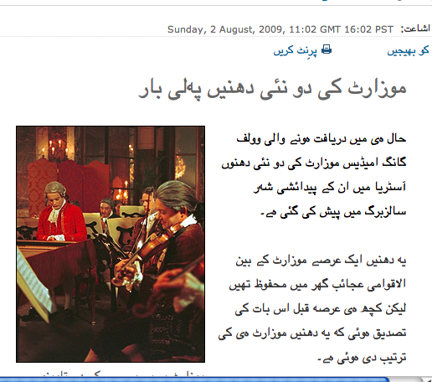
<title>‭BBC Urdu‬ - ‮فن فنکار‬ - ‮موزارٹ کی دو نئی دھنیں پہلی بار‬</title>
…
<meta name="dc.language" content="ur" />
<meta name="dc.publisher" content="British Broadcasting Corporation" />
…
<meta name="description”
content="حال ہی میں دریافت ہونے والی موزارٹ کی دو نئی دھنوں آسٹریا میں ان کے پیدائشی شہر سالزبرگ میں پیش کی گئی ہے۔" />
<meta name="keywords" content="Two new Mozart pieces performed" />
…
src="http://www.bbc.co.uk/worldservice/assets/images/2009/08/02/
090802104543_mozart_jt_283.jpg"

Slide 71
Rigid Designator Hypothesis
Problem Reduction: Finding Comparable Pairs → Search
Better clues for comparable corpora
  Numbers, Dates, Prices
  Proper Nouns
  Technical Terminology
  Pictures
  Good Keywords for Search Engines
    TF * IDF (low freq words)
Worse clues
  General Vocabulary (esp. high freq/ambig)

Slide 72
Jeopardy → Query Suggestions
Standard Search: Query→URL
    Continental airlines→ http://www.continental.com
Jeopardy: URL → Query
    http://www.continental.com → Continental Airlines
Double Jeopardy: URL₁ & URL₂ → Query
  Find a query that distinguishes URL₂ from URL₁
  Continental Check-in: Distinguishes Continental’s check-in page from their home page
Query suggestion

Slide 73
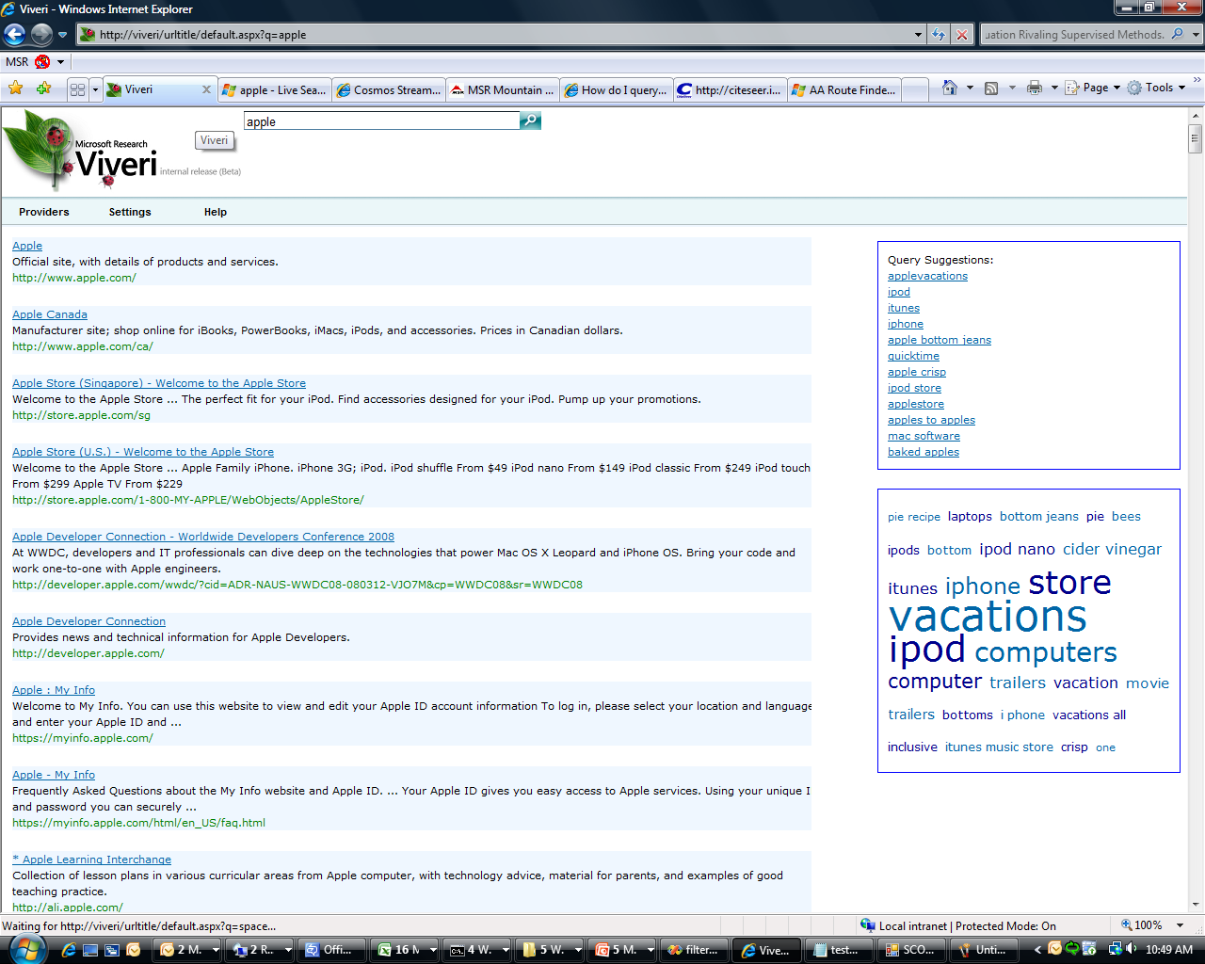
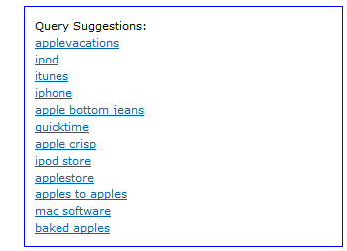
apple

Slide 74
Spelling suggestion: more than a suggestion
Entropy(Spelling Click | Query) | .01
Entropy(Spelling Click) | .11
Entropy(Spelling Click | User) | .08
google.co9m 97.1%
tmz.om 96.3%
raiglist 95.7%
City TV Toronto 0.0%
sink holes 0.0%
mens style 0.0%
Queries with clicks, June 1-7, 2008, en-us market, bot filtered

Slide 75
Spelling is Easier than Algo

Slide 76
Much Easier With the Query

Slide 77
Personalization Helps, But not as Much

Slide 78
Pattern Recognition Problems in Computational Linguistics
Information Retrieval:
  Is this doc more like relevant docs or irrelevant docs?
Author Identification:
  Is this doc more like author A’s docs or author B’s docs?
Word Sense Disambiguation
  Is the context of this use of bank
    more like sense 1’s contexts
    or like sense 2’s contexts?
Machine Translation
  Is the context of this use of drug more like those that were translated as drogue
  or those that were translated as medicament?

Slide 79
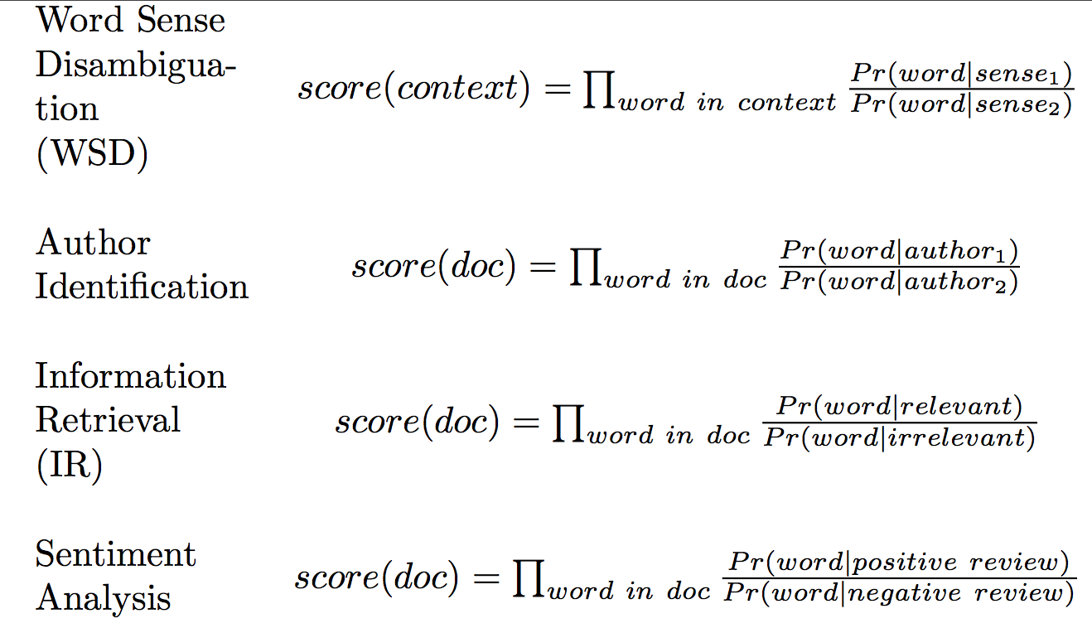
Applications of Naïve Bayes

Slide 80
Classical Information Retrieval (IR)
Boolean Combinations of Keywords
  Dominated the Market (before the web)
  Popular with Intermediaries (Librarians)
Rank Retrieval (Google)
  Sort a collection of documents
    (e.g., scientific papers, abstracts, paragraphs)
    by how much they ‘‘match’’ a query
  The query can be a (short) sequence of keywords
    or arbitrary text (e.g., one of the documents)

Slide 81
IR Models
Keywords (and Boolean combinations thereof)
Vector-Space ‘‘Model’’ (Salton, chap 10.1)
  Represent the query and the documents as V- dimensional vectors
  Sort vectors by
Probabilistic Retrieval Model
  (Salton, chap 10.3)
  Sort documents by

Slide 82
Rising Tide of Data Lifts All Boats
If you have a lot of data, then you don’t need a lot of methodology
1985: “There is no data like more data”
  Fighting words uttered by radical fringe elements (Mercer)
1993 Workshop on Very Large Corpora
  Perfect timing: Just before the web
  Couldn’t help but succeed
  Fate
1995: The Web changes everything
All you need is data (magic sauce)
  No linguistics
  No artificial intelligence (representation)
  No machine learning
  No statistics
  No error analysis
  No features

Slide 83
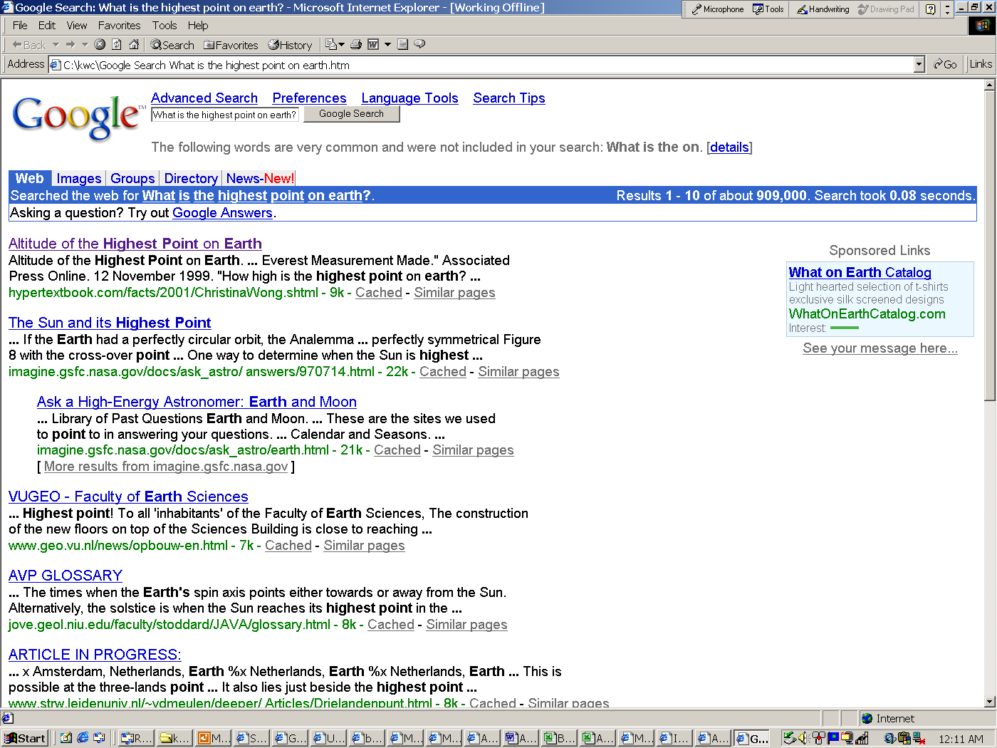
The rising tide of data will lift all boats!
TREC Question Answering & Google:
What is the highest point on Earth?

Slide 84
The rising tide of data will lift all boats!
Acquiring Lexical Resources from Data:
Dictionaries, Ontologies, WordNets, Language Models, etc. http://labs1.google.com/sets
England | Japan | Cat | cat
France | China | Dog | more
Germany | India | Horse | ls
Italy | Indonesia | Fish | rm
Ireland | Malaysia | Bird | mv
Spain | Korea | Rabbit | cd
Scotland | Taiwan | Cattle | cp
Belgium | Thailand | Rat | mkdir
Canada | Singapore | Livestock | man
Austria | Australia | Mouse | tail
Australia | Bangladesh | Human | pwd

Slide 85
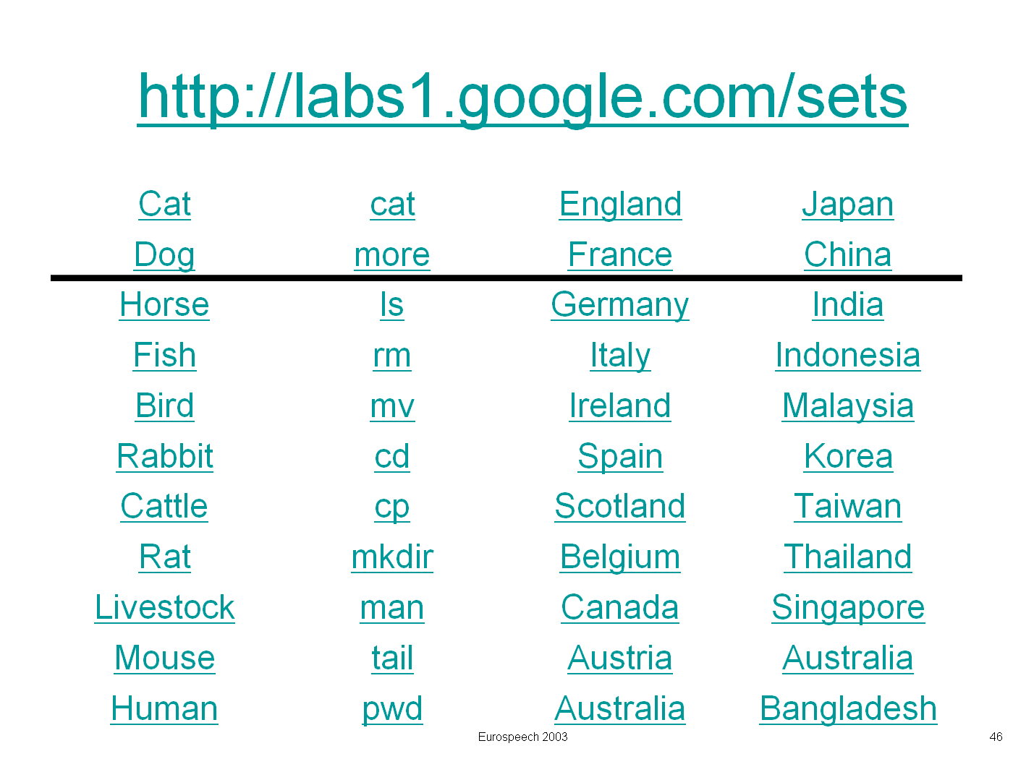
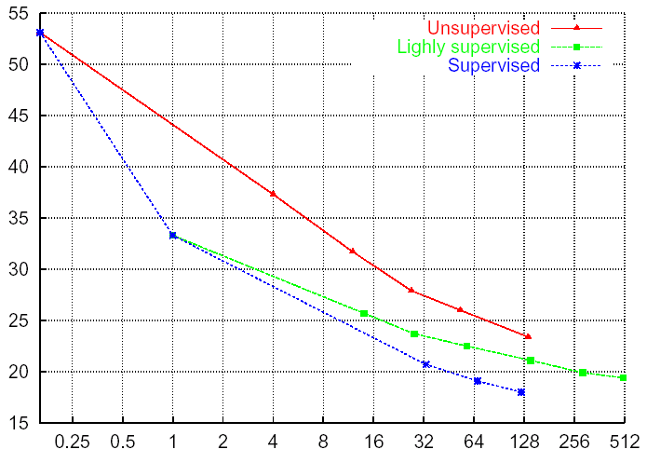
Rising Tide of Data Lifts All Boats
If you have a lot of data, then you don’t need a lot of methodology
More data → better results
  TREC Question Answering
    Remarkable performance: Google and not much else
      Norvig (ACL-02)
      AskMSR (SIGIR-02)
  Lexical Acquisition
    Google Sets
      We tried similar things
        but with tiny corpora
        which we called large

Slide 86
Trends over 25 Years &
Role of Features
The DDI (Don’t Do IT) Approach to Features
  There is no data like more data (Mercer, 1985)
  More data >> thinking (algorithms, features, etc.)
The Web is Large (But not that large)
Solitaire → Multi-Player Game
  Authors, Users, Advertisers, Spammers
  Features about Readers >> Features about Writers (tf, IDF, Page Rank)
Zero Resources & Speech + Classification
  Standard Practice (e.g., Gale):
    Connect black boxes (speech, IR, NLP) in Series
    Multiply Errors
    NA for low resource languages (all but English, Chinese, Arabic)
  Proposed alternative: Apply Classification directly to speech
    Without taking a dependency on ASR (Speech Recognition)

Slide 87
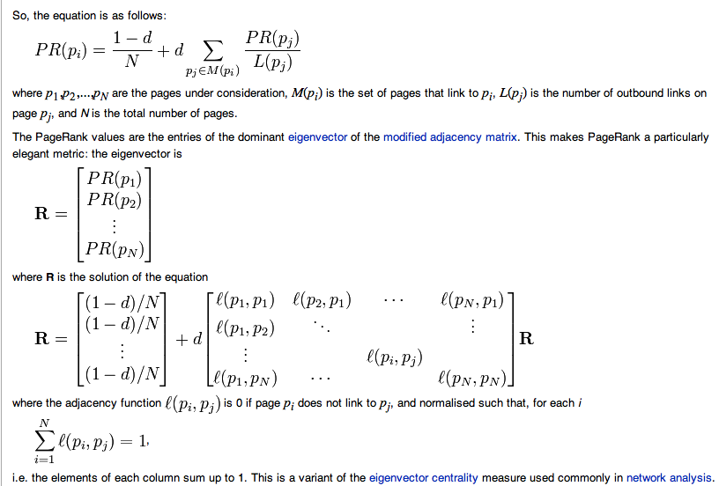
Page Rank = 1st Eigenvector http://en.wikipedia.org/wiki/PageRank

Slide 88
Broder Taxonomy
Navigational
  “greyhound bus”
Informational
  “cars”
Transactional
  “Internet explorer update”

Slide 89
Alternative Taxonomy: Type of Click
Navigational/Informational/Transactional
  Not annotated in the search logs
But logs distinguish clicks by type:
  spelling suggestion
  query suggestion
  ads
  algo
Classify queries by click type
  For example,
    Lots of clicks on spelling suggestions → Typo
    Logs of clicks on ads → Commercial Intent
      Wikipedia does well on lots of queries, but not commercial queries
Random Walks:
  Spread classifications to nearby queries & URLs

Slide 90
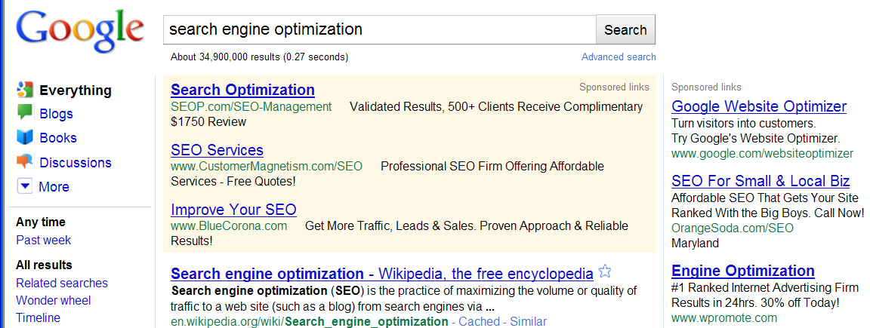
Effective Ads ↔ Ineffective Wikipedia

Slide 91
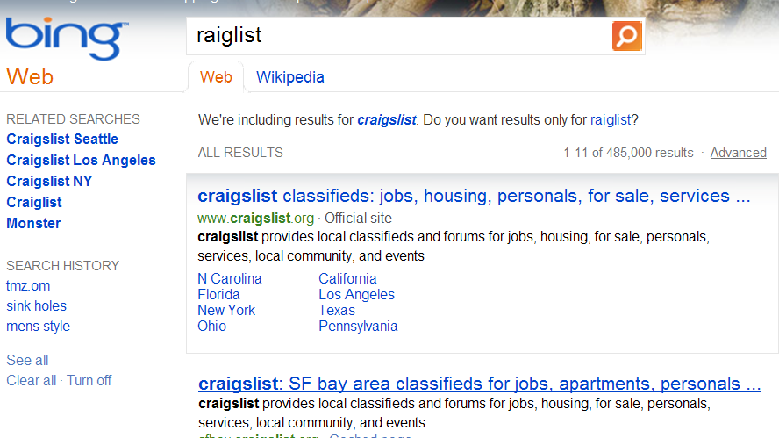
Query: raiglist → No Longer Asks: “Did you mean?”

