Slide 1
Online Feature Selection for Information Retrieval
Niranjan Balasubramanian
University of Massachusetts Amherst
Joint work with:
Giridhar Kumaran and Vitor Carvalho
Microsoft Corporation
James Allan
University of Massachusetts Amherst

Slide 2
A Better Title: Query-dependent Selection of Features During Ranking
Not feature selection during training as in the traditional machine learning sense
Not concerned with online learning methods

Slide 3
Outline
Online Feature Selection
Selecting Query representations – Query Reduction
Selecting Ranking Algorithms (Rankers)
Selecting Query Representations
Automatic Query Reduction on the Web
Selecting Ranking Algorithms
Selection experiments on Letor 3.0 dataset

Slide 4
Query Reduction for Long Queries
Long queries often contain terms that are not critical to the retrieval performance
Removing such terms leads to improved ranking effectiveness

Slide 5
Query Reduction as Online Feature Selection
Examples
query
{easter, egg, hunt}
term level features
TF, IDF, TF-Title, TF-Body
ranking function

Slide 6
Query Reduction as Online Feature Selection
query
term level features
selector function
indicates selection of a query term
ranking function
Query reduction (or query term selection) leads to removal of features that corresponds to query terms that are dropped.

Slide 7
Query Reduction as Online Feature Selection
query
term level features
ranking function without query term q₁
ranking function without query term q₂
Learning a query term selector function is equivalent to learning to select a ranking function or learning to select between corresponding result sets!
ranking function without query term q_{t}

Slide 8
Query Reduction
R²
Final
Results
Query
Search Engine
Q¹
R¹
Q²
M*
R²
Selector
(REEF)
Q³
R³
Query
Representations
Retrieval
Model
Results Sets

Slide 9
Selecting Rankers as Online Feature Selection
Examples
query
{easter, egg, hunt}
term level features
TF, IDF, TF-Title, TF-Body
selector function
indicates selection of a ranker
ranking function
BM25, TFIDF, RankSVM, ListNet

Slide 10
Selecting Rankers
R²
Final
Results
Query
Search Engine
List
Net
R¹
Q*
Rank
SVM
R²
Selector
Rank
Net
R³
Query
Representation
Ranking
Algorithms
Results Sets

Slide 11
Outline
Online Feature Selection
Selecting Query representations – Query Reduction
Selecting Ranking Algorithms (Rankers)
Selecting Query Representations
Automatic Query Reduction on the Web
[Balasubramanian et al, SIGIR 2010]
Selecting Ranking Algorithms
Selection experiments on Letor 3.0 dataset
[Balasubramanian et al, SIGIR 2010]

Slide 12
Exploring Reductions for Long Web Queries [Balasubramanian et al, SIGIR 2010]
Retrieval effectiveness is lower for longer queries.
Effectiveness of LambdaRank on a large sample (> 2000) of Web queries.

Slide 13
egg hunts in northeast columbus parks and recreation centers

Slide 14
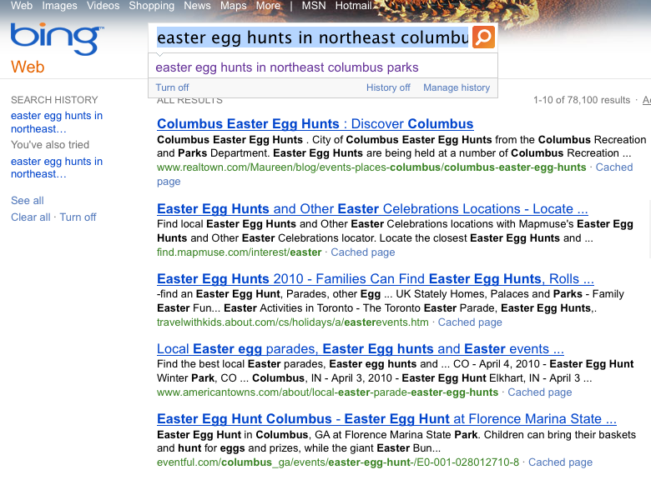
egg hunts in northeast columbus parks

Slide 15
Automatic Query Reduction
Final
Results
Query
R^{P2}
Search Engine
Q
Ranking
Algoritm
R^{Q}
f11 | f12 | … | f1n
P1
Ranking
Algoritm
R^{P1}
Learning
Formulation
f21 | f22 | … | f2n
P2
Ranking
Algoritm
R^{P2}
f31 | f32 | … | f3n
Query
Versions
Results
Sets
Features

Slide 16
Features
1. Query-dependent [Pre-retrieval]
2. Query-Document [Post-retrieval]

Slide 17
Features
Query-dependent [Pre-retrieval] | Query Length Has URL Has Location Has Stopwords
Some queries are easier than others
Navigational vs. Informational
Short keyword vs. longer queries
Use lexical features that are indicative of these categories
Notes:
We use two types of features. Query-dependent and results-set based features
The query dependent features can be viewed as features that encode the difficulty of the queries apriori – before retrieval.
We know that certain types of queries are easier than others. For example, local queries, navigational queries (queries that contain urls) are often easier than topical queries or informational queries. Instead of trying to categorize queries into these bins, we simply use features that are indicative of these bins.
Next, we use features that characterize the quality of the retrieved result sets. We use retrieval scores and features used by the retrieval algorithms themselves.
It makes sense to use retrieval scores as the models are designed to produce higher scores for documents with higher relevance and lower scores for documents with lower relevance. However, the main issue is that these scores are query dependent and cannot be compared across queries easily. To account for this we also use aggregates of the retrieavl scores.
The second set of features we use are built based on the results set. We mainly use two types of results set features. First, we use the retrieval scores assigned by the retrieval algorithm itself.

Slide 18
Features
Query-Document [Post-retrieval] | Retrieval Scores | rank_1, rank_2,… mean, geo_mean, stdev, …
 | Retrieval Features | mean, geo_mean, stdev, …
Retrieval scores are designed to reflect document relevance
Use aggregates - mean, stdev, var etc.
Retrieval features are also indicative of document relevance
Use aggregates.
Readily available during ranking and easily integrated into existing search engines!
Notes:
We use two types of features. Query-dependent and results-set based features
The query dependent features can be viewed as features that encode the difficulty of the queries apriori – before retrieval.
We know that certain types of queries are easier than others. For example, local queries, navigational queries (queries that contain urls) are often easier than topical queries or informational queries. Instead of trying to categorize queries into these bins, we simply use features that are indicative of these bins.
Next, we use features that characterize the quality of the retrieved result sets. We use retrieval scores and features used by the retrieval algorithms themselves.
It makes sense to use retrieval scores as the models are designed to produce higher scores for documents with higher relevance and lower scores for documents with lower relevance. However, the main issue is that these scores are query dependent and cannot be compared across queries easily. To account for this we also use aggregates of the retrieavl scores.
The second set of features we use are built based on the results set. We mainly use two types of results set features. First, we use the retrieval scores assigned by the retrieval algorithm itself.

Slide 19
Learning Formulations
Independent Regression
Difference Regression
Ranking

Slide 20
Learning Formulations
Independent [Random Forest Regression]
Predict the effectiveness of each query and its reduced versions independently
Select the query with the highest predicted effectiveness
Does not encode relationships between original and reduced queries
Predicts effectiveness independently
Is solving a harder problem than necessary
We care about the induced ordering
Not the accurate prediction of absolute effectiveness

Slide 21
Learning Formulations
Difference [Random Forest Regression]
Predict difference in effectiveness between each reduced query and the original query
Select the reduced version with the largest positive difference
If none exist, select the original query
Ranking [RankSVM]
Rank the reduced queries based on preferences over the original query
Select the reduced version with the largest positive preference over the original query
If none exist, select the original query

Slide 22
Experiments
Query Replacement This talk
If a reduced version is selected use it in place of the original query
Interleaving Results
If a reduced version is selected, then merge the results of the reduced version and the original query using interleaving

Slide 23
Experiments
Queries - 6450 long queries submitted to
Ranking Algorithm – LambdaRank
Uses Click-based, BM25F, and document quality features.
Aggregate Features – Top 100 features that are highly correlated with NDCG@5
Judgments
Create reduced versions by dropping one term at a time
Pool results for the original long query and reduced versions
Judge pooled results with respect to the original long query
Evaluation
NDCG@5
5-Fold Cross validation

Slide 24
Query Replacement Results
Original NDCG@5: 38.19
Formulation | Average Replacement Gain | Avg. Gain on subset | Affected Queries
Independent | -3.01 | -4.26 | 4567 (70%)
Difference | 0.44 | 1.61 | 1761 (27%)
Ranking | 0.31 | 4.64 | 612 (9%)
Independent is substantially worse
No relationship between original and reduced versions
Regression on absolute NDCG@5 appears to be harder
Difference and Ranking provide small but significant gains
Gain on subset of queries for which reduced version
is chosen is much higher
Independent chooses reduced versions for a large number
Difference and Ranking are more conservative

Slide 25
Query Replacement Results
Original NDCG@5: 38.19
Formulation | Average Replacement Gain | Avg. Gain on subset | Affected Queries
Independent | -3.01 | -4.26 | 4567 (70%)
Difference | 0.44 | 1.61 | 1761 (27%)
Ranking | 0.31 | 4.64 | 612 (9%)
Independent is substantially worse
No relationship between original and reduced versions
Regression on absolute NDCG@5 appears to be harder
Difference and Ranking provide small but significant gains
Gain on subset of queries for which reduced version
is chosen is much higher
Independent chooses reduced versions for a large number
Difference and Ranking are more conservative

Slide 26
Thresholding
Idea: Select a reduced version only if the predicted value exceeds
a specified threshold
Original NDCG@5: 38.19
No Thresholding
Formulation | Average Replacement Gain | Avg. Gain on subset | Affected Queries
Independent | -3.01 | -4.26 | 4567 (70%)
Difference | 0.44 | 1.61 | 1761 (27%)
Ranking | 0.31 | 4.64 | 612 (9%)
With
Thresholding
Formulation | Average Replacement Gain | Avg. Gain on subset | Affected Queries
Independent | 0.45 | 6.33 | 457 (7%)
Difference | 0.44 | 1.61 | 1761 (27%)
Ranking | 0.31 | 4.64 | 612 (9%)

Slide 27
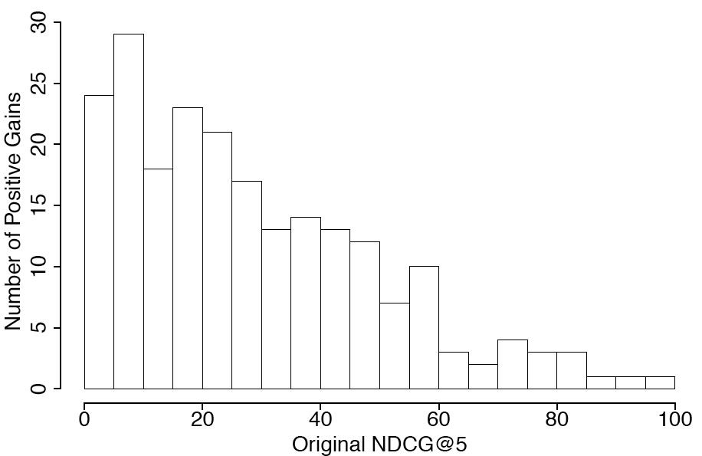
Improvement where it matters!
Query reduction mostly benefits poorly performing queries!

Slide 28
Outline
Online Feature Selection
Selecting Query representations – Query Reduction
Selecting Ranking Algorithms (Rankers)
Selecting Query Representations
Automatic Query Reduction on the Web
Selecting Ranking Algorithms
Selection experiments on Letor 3.0 dataset

Slide 29
Selecting Rankers
R²
Final
Results
Query
Search Engine
List
Net
R¹
Q*
Rank
SVM
R²
Evaluator
Rank
Net
R³
Query
Representation
Ranking
Algorithms
Results Sets

Slide 30
Selecting between Two Rankers [Balasubramanian et al, SIGIR 2010]
Datat set : 225 queries from the Letor 3.0 Data set
Rankers : RankBoost, Regression, FRank
Task : Select best ranker for each query.
Evaluation : MAP
Features : Scores assigned by the rankers
: Aggregates of the features of the top ranked documents
R_{base} | R_{alt} | MAP(R_{base}) | MAP(R_{alt}) | MAP(R_{s})
Regression | RankBoost | 0.5476 | 0.6596 | 0.6623*
FRank | RankBoost | 0.6429 | 0.6596 | 0.6591*
RankBoost | Regression | 0.6596 | 0.5476 | 0.6722*
RankBoost | FRank | 0.6596 | 0.6429 | 0.6607*

Slide 31
Ranker Selection for Fusion using CombMNZ
Datat set : 125 Topic Distillation queries from the Letor 3.0 Data set
Rankers : RankBoost, Regression, Frank, RankSVM, ListNet, AdaRank (2)
Evaluation : MAP
Features : Scores assigned by the rankers
: Aggregates of the features of the top ranked documents

Slide 32
Conclusions and Future Work
Selecting query representations can be viewed as query-dependent selection of features or as online feature selection.
Query-dependent selection using retrieval scores and retrieval features shows promise
Significant improvements for automatic query reduction
Improvements when selecting between two ranking algorithms.
Efficiency and variance are important issues in query-dependent selection
Two-staged approach that performs selection only when necessary
Mechanisms that trade-off performance for robustness in selection.
Online selection of rankers trained with different feature subsets.

