Slide 1
Recitation 10: Bayes Nets
Part 2: Structure Learning
Main Source: F2010 Probabilistic Graphical Models, instructor: Noah Smith
Suggested Reading: Shay Cohen’s recitation notes
http://select.cs.cmu.edu/class/10701-F09/recitations/recitation10.pdf

Slide 2
Learning Bayesian Networks
 | Known Structure | Unknown Structure
Fully Observed Data | EASY (estimate CPT) | HARD (structure + CPT)
Missing Data | HARD (Variational Methods) | VERY HARD

Slide 3
BN Learning for Known Structure
MLE for a BN whose CPDs (Conditional Probability Distributions) have disjoint parameters =
MLEs for each of its CPDs
=> Estimate MLEs for the parameters of the conditionals

Slide 4
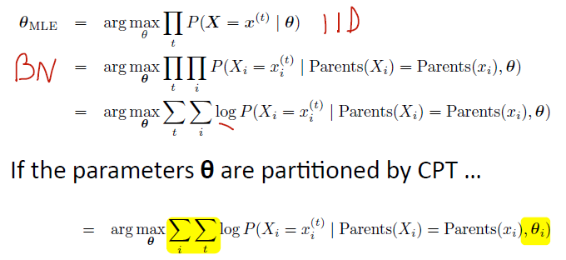
Decomposability

Slide 5
Deriving the MLE
Most common distributions have closed forms for the MLE – you’ve used them
Useful to know what distributions you obtain when you condition
Solve analytically, for every parameter:
Convex optimization

Slide 6
Learning Structure
Same principle: maximizing the likelihood of the data
Alternative:
use stat. tests to det. cond. independencies
construct the corresponding PDAG
Idea: use likelihood to score structures

Slide 7
Likelihood and BN structures
For every possible structure, consider it with its best possible parameters (MLE)
Optimistic, but correct if the overall goal is maximizing likelihood

Slide 8
Deriving the structure score for G

Slide 9
Deriving the structure score for G

Slide 10
Decomposition
Structure’s likelihood decomposes by family => increased efficiency
directly related to structure
doesn’t depend on structure

Slide 11
Problem with Mutual Information
Unless conditional independence holds exactly in the data, more connections are always better!
For structure, MLE is guaranteed to
OVERFIT
$$≤$$

Slide 12
Possible Solution: Chow-Liu
Each node can have at most one parent
Structure will have at most n-1 edges
Decision is where to place the edges
Algorithm:
Consider $I(X_{i},X_{j})$ to be the score of putting an edge between $X_{i}$ and $X_{j}$
Find the maximum spanning tree
Number of trees? $O(2^{nlog(n)})$

Slide 13
Possible Solution: Chow-Liu
Each node can have at most one parent
Structure will have at most n-1 edges
Decision is where to place the edges
Algorithm:
Consider $I(X_{i},X_{j})$ to be the score of putting an edge between $X_{i}$ and $X_{j}$
Find the maximum spanning tree
Pick root, traverse to get structure

Slide 14
Possible Solution: Chow-Liu
Maximum-scoring spanning trees gives the skeleton
Trees with the same skeleton have
The same conditional independence assertions
The same mutual information score
The resulting model has no V-structures

Slide 15
Not covered (yet)
Being Bayesian: priors on structure
Consistent* Scores:
Bayesian Score and modularity
Bayesian Information Criterion (BIC)
Penalizes model dimension by log(m)/2
Structure search
* as the number of samples goes to infinity, the recovered structure is ‘I-equivalent’ to the map of the true distribution

